Slide 1
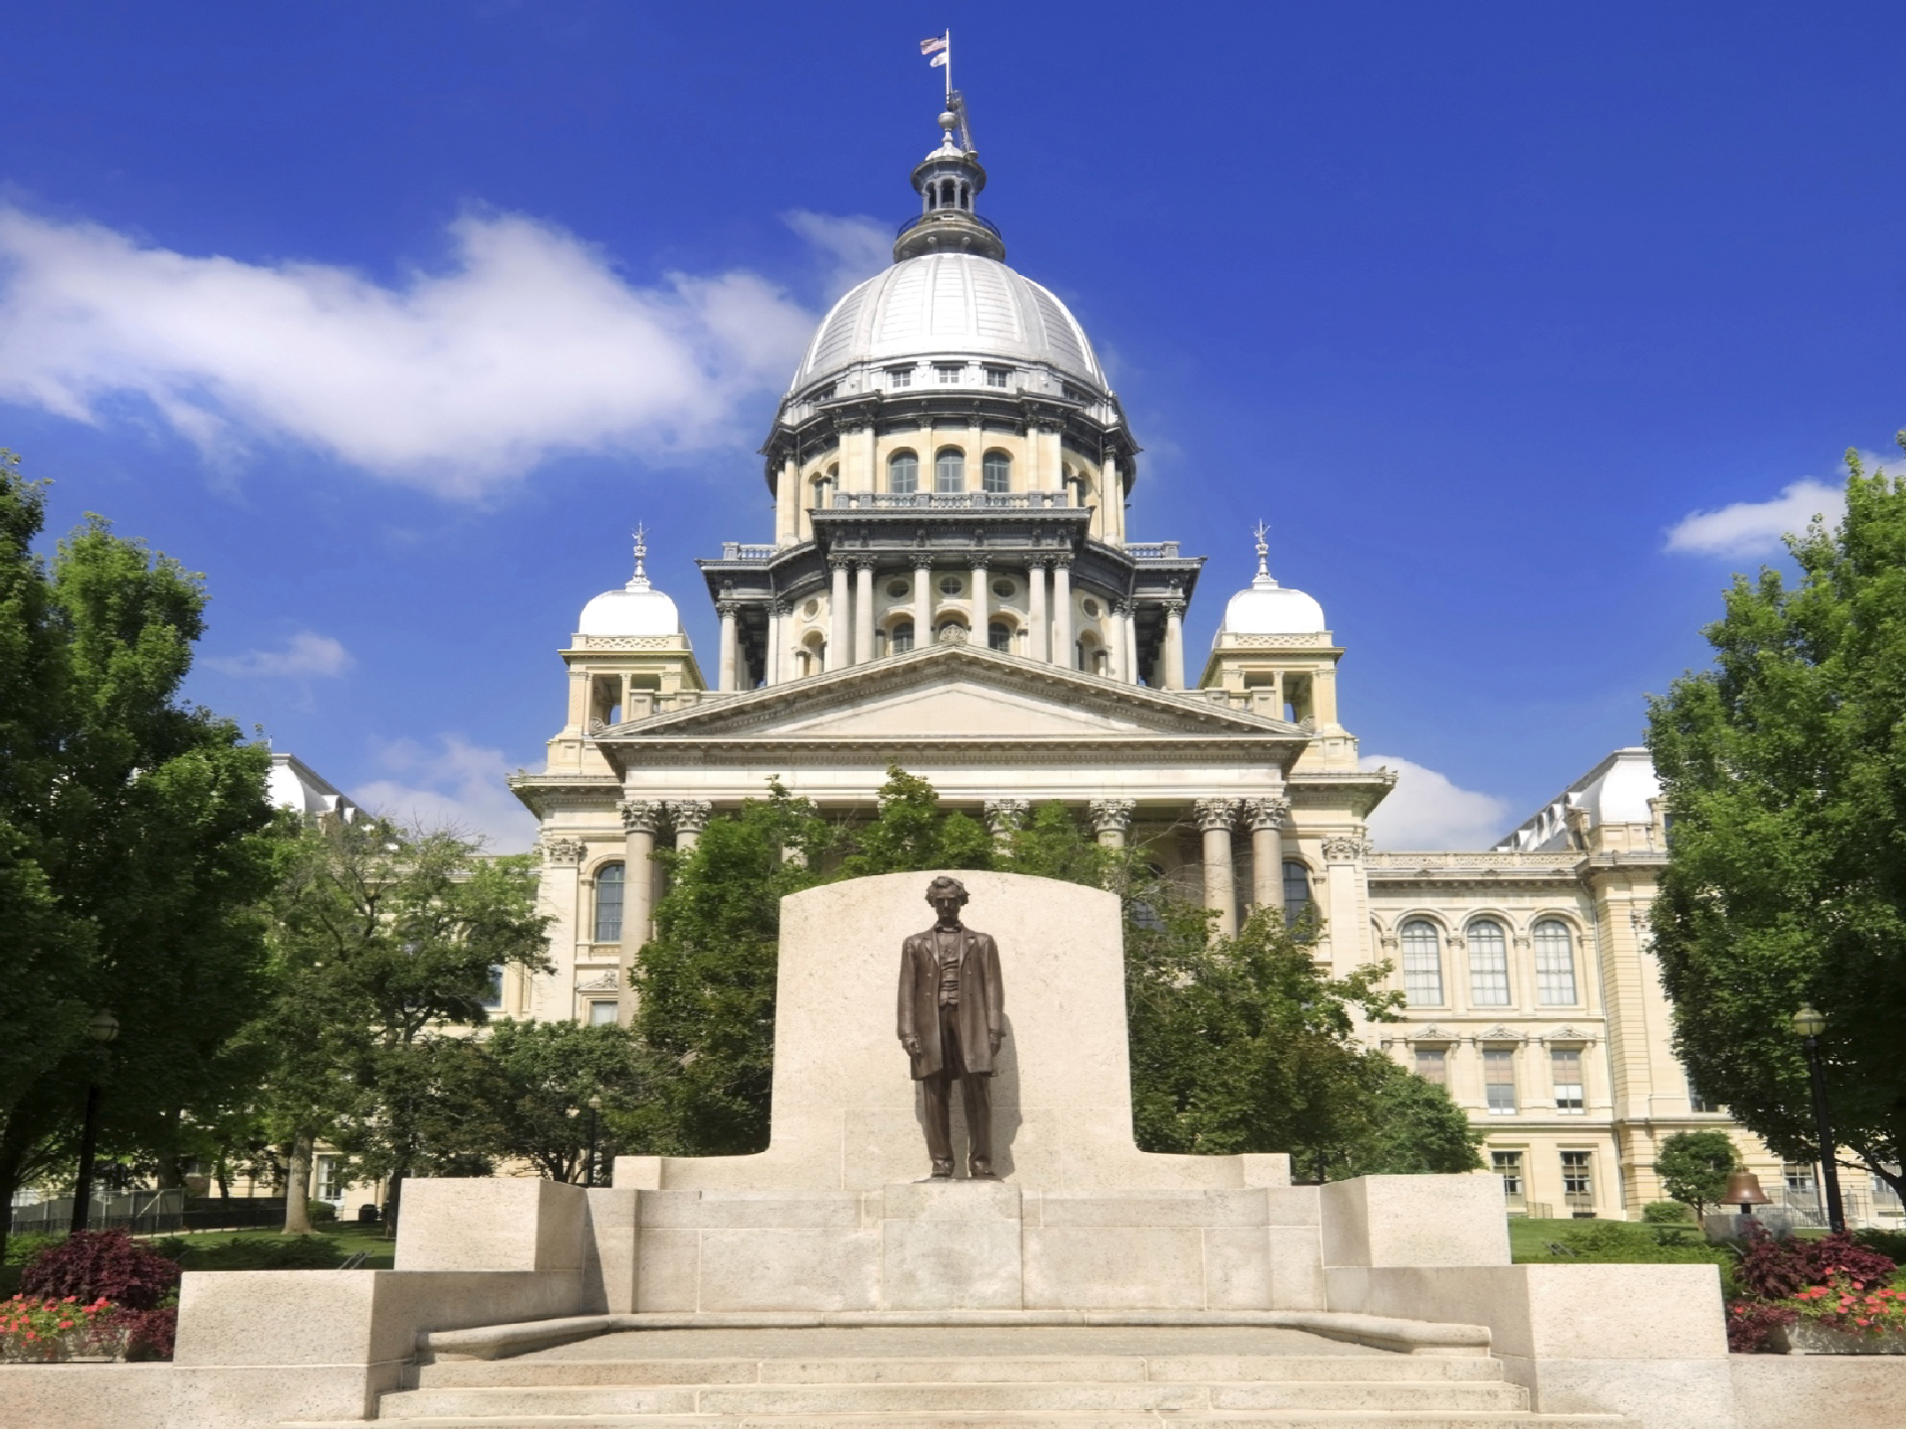





ILLINOIS DEPARTMENT OF COMMERCE
Office of Entrepreneurship, Innovation & Technology (EIT)
ILLINOIS DEPARTMENT OF COMMERCE & ECONOMIC OPPORTUNITY
1

Slide 2






THE OFFICE OF ENTREPRENEURSHIP, INNOVATION AND TECHNOLOGY
The Office of Entrepreneurship, Innovation & Technology supports entrepreneurs and small businesses by providing services, information, and support.
The First Stop Business Information Center Obtain comprehensive regulatory and permitting information. We offer a toll-free helpline and a library of online resources for entrepreneurs.
The Illinois Small Business Development Centers (SBDCs) provide assistance with business plans, marketing, financing and financial analysis and training. International Trade Centers (ITCs) provide assistance with international trade and exporting at no cost to the clients.
The Illinois Procurement Technical Assistance Centers (PTACs), provide assistance to businesses looking to enter the world of government contracting.
The Small Business Environmental Assistance Program provides free and confidential assistance to help small businesses understand their environmental obligations.
THE ILLINOIS DEPARTMENT OF COMMERCE IS YOUR ONE-STOP RESOURCE
2
2

Slide 3







Small Business – Our Nation’s Job Creators
Small Businesses:
Employ 47.8% of the private workforce
Pay 41.1% of total U.S. private payroll
Account for 99.7% of all firms with paid employees
Created 62.4% of net new jobs in the past 24 years
PROVIDING PROFESSIONAL GUIDANCE FOR BUSINESS GROWTH
3

Slide 4

Small Business Challenges
FACT:
New regulations unduly burden small businesses by adding complexity, paperwork, licensing, training, permits or requiring additional staff
Small businesses lack the resources to fight regulations like larger companies
Often times small businesses get lumped into a “one size fits all” rulemaking.
PROVIDING PROFESSIONAL GUIDANCE FOR BUSINESS GROWTH
4

Slide 5

Small Business Regulatory Flexibility Program
Overview
If you are a small business owner concerned about proposed state regulations that could affect your business, the Regulatory Flexibility Program works with businesses to determine ways to make rules more flexible, cost effective or less restrictive.
Our staff reviews every rule that state agencies propose and work to inform the small business community about these rules.
We encourage public involvement and solicit comments on the potential impact of rules.
Take feedback from the community and work with the Joint Committee on Administrative Rules (JCAR), the oversight committee for rules promulgated by state agencies. They ultimately determine what rules are adopted and what rules need to be changed.
Office of Regulatory Flexibility submits around 50-75 SBIAs per year
PROVIDING PROFESSIONAL GUIDANCE FOR BUSINESS GROWTH
5

Slide 6
Rulemaking Process
State agencies must follow certain procedures when creating or changing rules that impact businesses according to the Illinois Administrative Procedure Act. JCAR oversees the process on behalf of the General Assembly.
When rules are proposed, they undergo a 45-day public comment period before adoption.
“First Notice Period” -- VERY IMPORTANT TO GET INVOLVED!
After 45 days a rule goes to “Second Notice” where the agency must address public comments and concerns brought forth during First Notice.
After Second Notice, JCAR members take action based on public feedback. At this time, they either adopt the rule, recommend changes, or prohibit the agency from adopting it because they believe it is not in the public interest.
PROVIDING PROFESSIONAL GUIDANCE FOR BUSINESS GROWTH
6

Slide 7
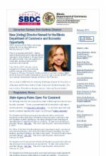
“The Small Business Connection”
Monthly newsletter for small businesses, chambers of commerce, business and trade groups
Contains information on state and federal rules/regs info on state agency programs, workshops, trainings, changes in permitting and licensing, tax information
Readers can ask questions, give immediate feedback, or submit comments on proposed rules
February Small Business Connection Over 4,000 Subscribers!
,
PROVIDING PROFESSIONAL GUIDANCE FOR BUSINESS GROWTH
7

Slide 8

PROVIDING PROFESSIONAL GUIDANCE FOR BUSINESS GROWTH
8

Slide 9
A New Public Act – PA 100-0688 – Effective 1/1/19
Requires state agencies to declare which industries are impacted when they file a new rule or change to existing rule.
Will it impact hiring? Require additional staffing? Insurance changes? Licensing Fees? Recordkeeping? Additional training? Compensation and benefits?
Requires DCEO to host website of all proposed rules, a brief summary, the potential impact, and where/how to get more information.
PROVIDING PROFESSIONAL GUIDANCE FOR BUSINESS GROWTH
9

Slide 10


First Stop Business Information Center (800) 252-2923
Free – Confidential
PROVIDING PROFESSIONAL GUIDANCE FOR BUSINESS GROWTH
10

Slide 11




THANK YOU!
CONTACT INFORMATION:
KATY KHAYYAT
MANAGER, OFFICE OF REGULATORY FLEXIBILITY 800.252.2923
217.558.0190
KATY.KHAYYAT@ILLINOIS.GOV WWW.ILDCEO.NET WWW.ILDCEO.NET/REGALERT
PLEASE CONTACT US FOR MORE INFORMATION
2934
For More Information:
First Stop Information Center Help Line
800.252.2923

Slide 12
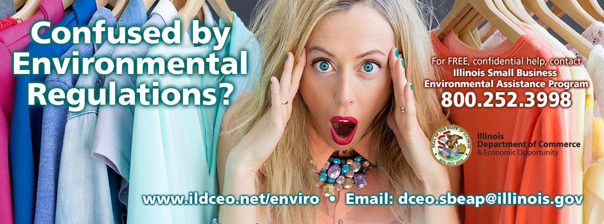






ILLINOIS SMALL BUSINESS ENVIRONMENTAL ASSISTANCE PROGRAM

Slide 13



SECTION 507 FEDERAL MANDATE
Congress recognized that small businesses lacked resources and needed help to understand and comply with complex environmental regulations.
Section 507 of the 1990 Clean Air Act (CAA) Amendments requires states and territories to set up programs to help small businesses
Notes:
Presenter
2019-02-15 00:41:11
--------------------------------------------
In 1990, President Bush signed into law the Clean Air Act Amendments of 1990. Among other provisions, the Act placed new federal controls on small sources of air pollution that ultimately affected hundreds of thousands of small American businesses.
The Act establishes certain criteria that a company must meet to qualify for assistance as a small businesses. In general, it must be independently owned and operated and a business that is not dominant in its field. The business must be owned by a person who employs 100 or few individuals.

Slide 14

3 MANDATED COMPONENTS UNDER SECTION 507 OF THE CAA
Technical Assistance Program
Ombudsman
Compliance Advisory Panel

Slide 15

Small Business Environmental Assistance Program
Technical Assistance Component
Located in the non-regulatory state agency to alleviate clients fears of enforcement in seeking assistance
Free and confidential
The Goal:
Reduce the regulatory burden on small businesses while protecting the environment through education & compliance assistance.
Notes:
Presenter
2019-02-15 00:41:11
--------------------------------------------
The program was intentionally located in the non-regulatory agency to alleviate the fears that small businesses have of the regulatory agency. Our goal is to hekp small businesses get into compliance with environmental regulations. Our focus is on air because that’s where the funding comes from, but we don’t turn people away who have land and water issues. We develop a workplan with IEPA on an annual basis, identifying business sectors that need outreach and education.

Slide 16

SMALL BUSINESS ENVIRONMENTAL ASSISTANCE PROGRAM’S ROLE
Provide technical guidance, materials, and assistance to small businesses on:
Applicable requirements
General and sector-specific notices of upcoming rules and regulations
Rights of small businesses
Compliance methods and control technologies
Pollution and release prevention
Permitting guidance and assistance
Refer small businesses to appropriate specialists

Slide 17

SMALL BUSINESS OMBUDSMAN
Develop, or review and comment on, pertinent environmental materials and guidance for small businesses
Disseminate pertinent environmental materials and guidance to small businesses
Make recommendations to regulators about regulations impacting small businesses
Advocate for small businesses within the state agency
Facilitate and promote discussion of issues between small businesses and the agency

Slide 18

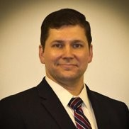

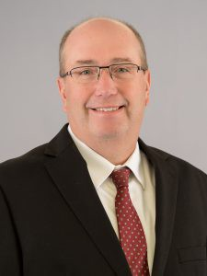
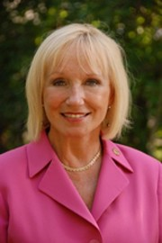
ILLINOIS COMPLIANCE ADVISORY PANEL APPOINTEES
Mark Grant
State Director NFIB of IL
* CAP Chair
Alec Davis Executive Director IERG
Karen May Retired State Representative Former Chair, Environmental Health Committee Illinois House of Representatives
Bharat Mathur
Retired
USEPA Deputy Regional Administrator / Acting Regional Administrator / Director, Air and Radiation Division
John Lee
Safety Health Environmental Services Director
Feed & Grain Association of IL
1 VACANCY
*Bureau of Air Chief, Julie Armitage serves as the IEPA representative

Slide 19
ILLINOIS COMPLIANCE ADVISORY PANEL ROLE
Render advisory opinions on the effectiveness of SBEAP and difficulties encountered by small businesses
Review materials, regulations, and legislation to ensure they are understandable to small businesses
Identify issues of concern to small businesses
Advocate for small businesses with legislators and senior state agency management
*Staff support provided by the DCEO SBEAP

Slide 20

WHY IS SMALL BUSINESS ENVIRONMENTAL COMPLIANCE ASSISTANCE IMPORTANT?
46% of Illinoisans are employed by small businesses (2.5 million)
80% of net new job growth & capital investment comes from Illinois’ existing businesses.
Costs per employee of environmental regulations are more than 4 times higher in small firms than in large firms

Slide 21
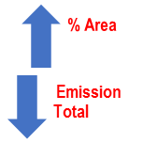
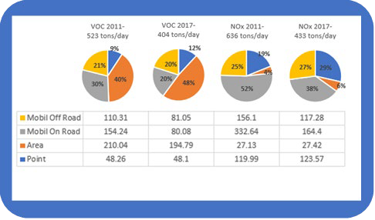
WHY IS SMALL BUSINESS COMPLIANCE IMPORTANT?
Chicago Area Data ↑ 8% VOC ↑ 2% NOX Change

Slide 22
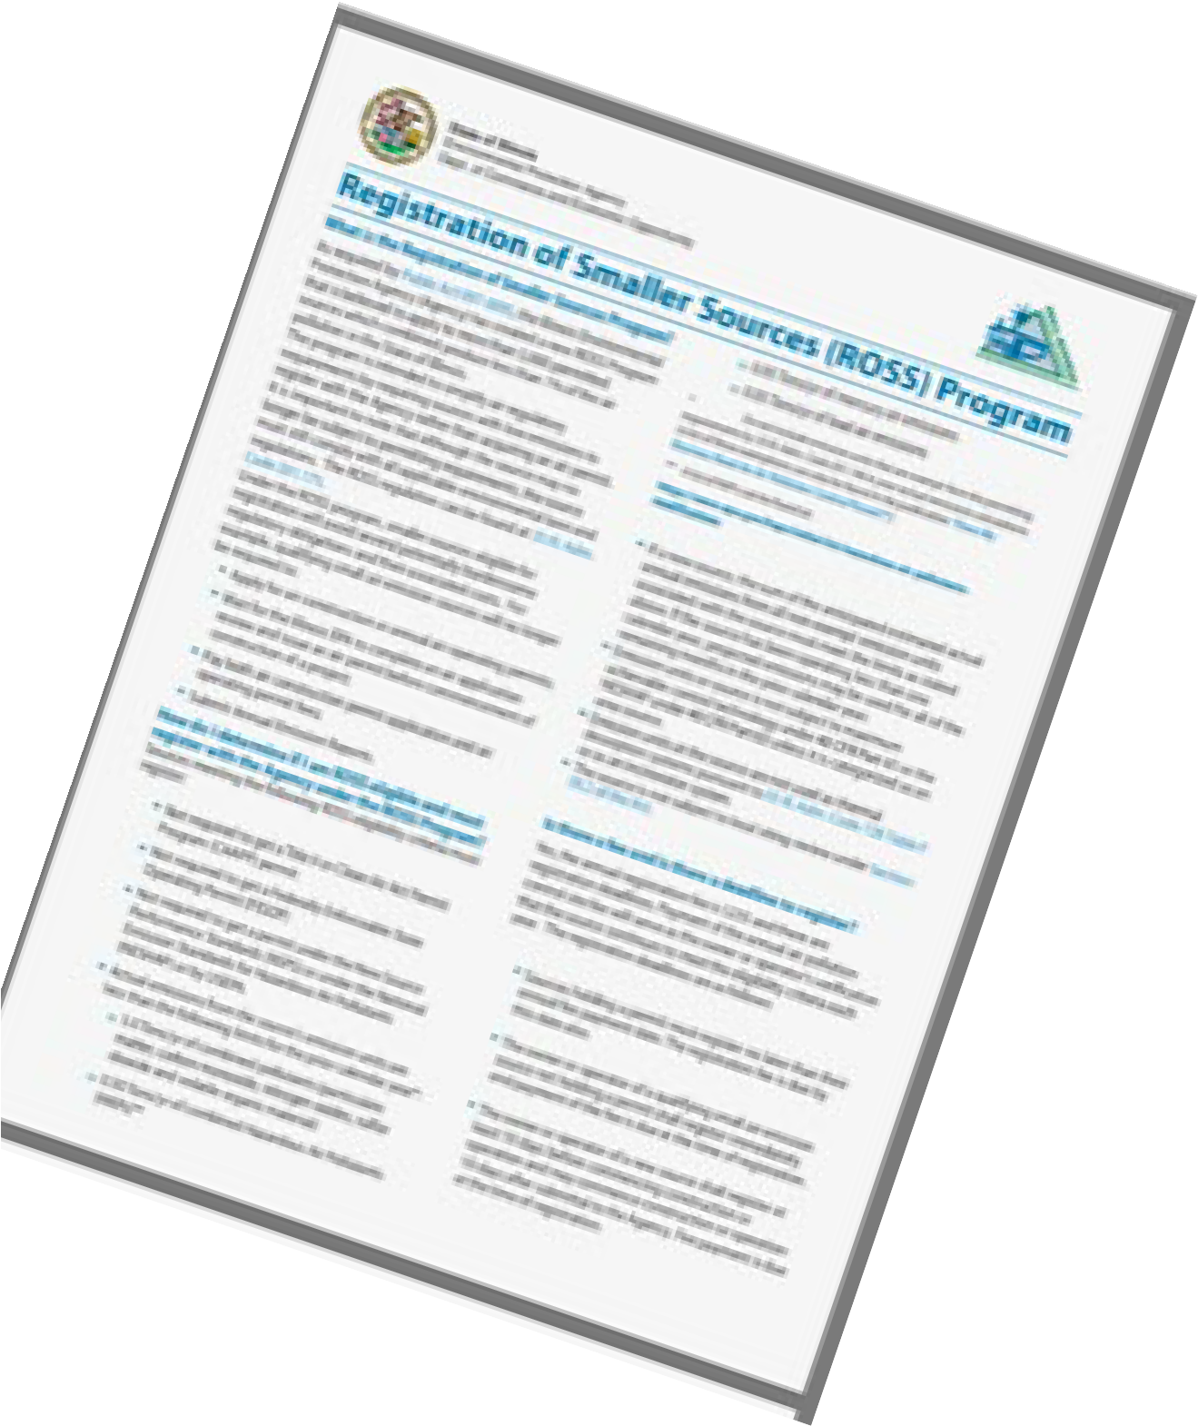
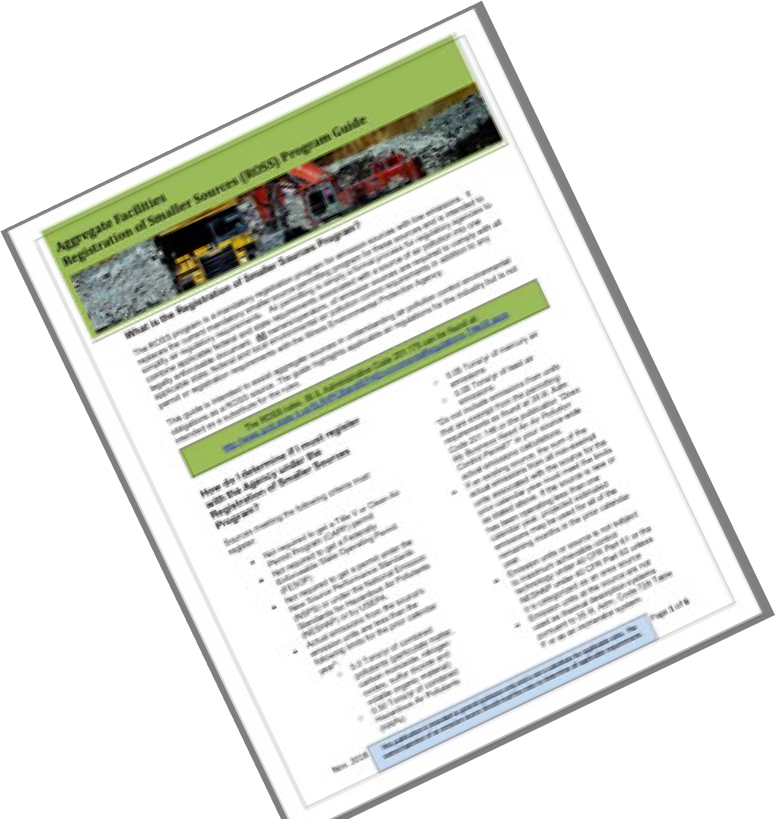
WHO DO WE HELP?
Thousands of Illinois’ small businesses have become regulated by over 70 federal regulations targeting control of 90% of emissions of 30 hazardous air pollutants from area sources
4987 of 6240 (80%) total IEPA Bureau of Air permitted or registered sources are small businesses (area sources)
3657 small businesses are registered under the IEPA’s Registration of Smaller Sources (ROSS) Program
Notes:
Presenter
2019-02-15 00:41:12
--------------------------------------------
On our website, there’s permitting forms, a directory of environmental consultants, easy-to-read fact sheets, and links to environmental regulations, as well as other state and federal compliance assistance tools.

Slide 23



How Can We Help?
Assistance in determining eligibility for & complying with the Registration of Smaller Sources Program (ROSS)
Assistance in determining & complying with the appropriate level of air permitting (Lifetime, General, FESOP, Title V)
Assistance in determining applicability of & compliance with National Emission Standards for Hazardous Air Pollutants
Assistance with Asbestos requirements for commercial and public buildings
Assistance with other state and federal regulations

Slide 24




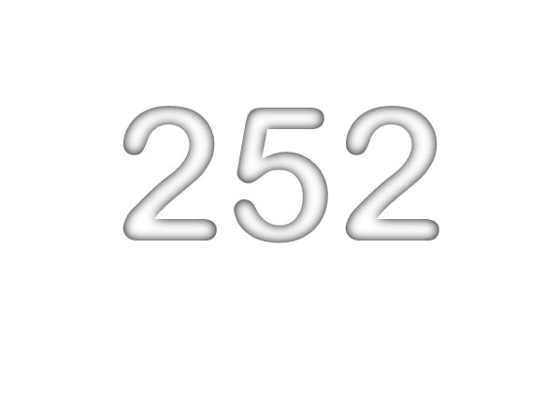
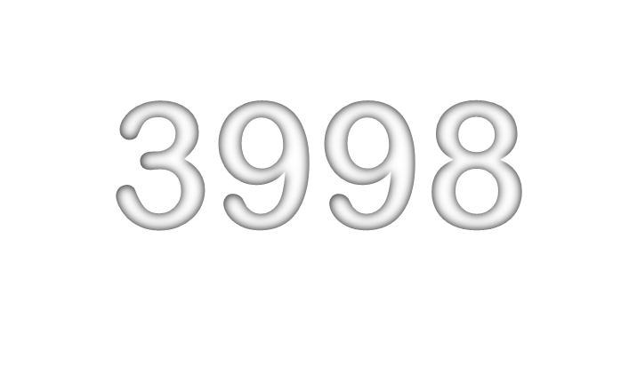
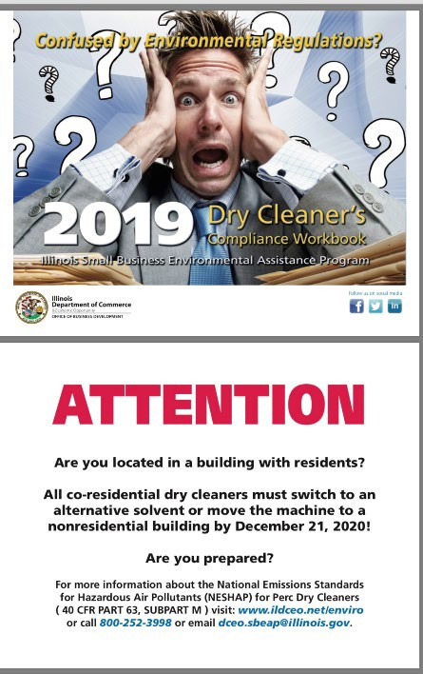
COMPLIANCE ASSISTANCE TOOLS
Toll-free helpline: 800-252-3998
Environmental recordkeeping tools
Easy to understand publications & factsheets
Educational Seminars/Workshops
One-on-one technical assistance
Facilitated meetings with the regulatory agency
www.ildceo.net/enviro

Slide 25


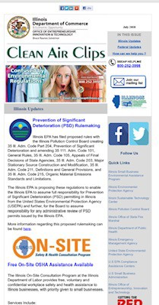

Clean Air Clips Electronic Newsletter
To Subscribe From Your mobile device text ILSMALLBIZ to 22828
Find Us on Social Media!
@ILSBEAP
@SBEAP_IL

Slide 26








Serving Small Business & the Environment
Illinois Department of Commerce & Economic Opportunity
Annette Fulgenzi, Program Manager Annette.Fulgenzi@Illinois.gov
217-785-8019
Notes:
Presenter
2019-02-15 00:41:14
--------------------------------------------
Address:
1. Background of the program
2. Services, information, and programs available Results

