Slide 2
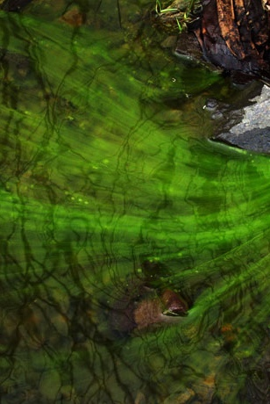
Harmful Algae Blooms (HABs):
A Regional and Nationwide Concern
William Goodfellow, Margaret McArdle, and Kendra Brown
Exponent
December 5, 2018
Illinois Pollution Control Board

Slide 3
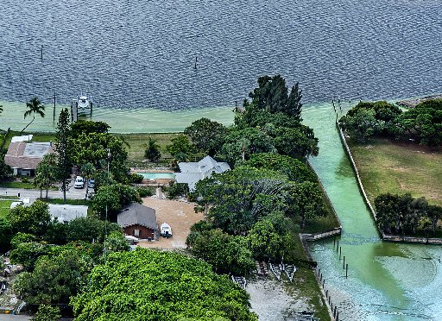
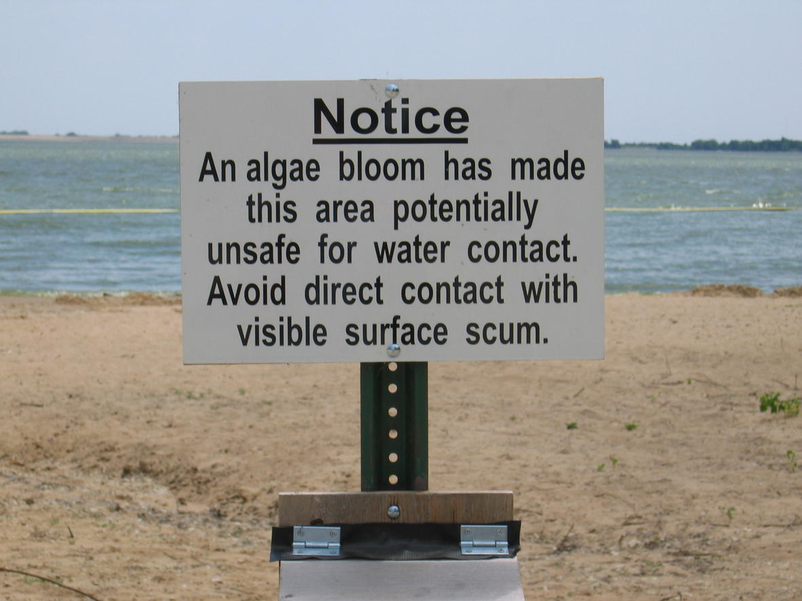
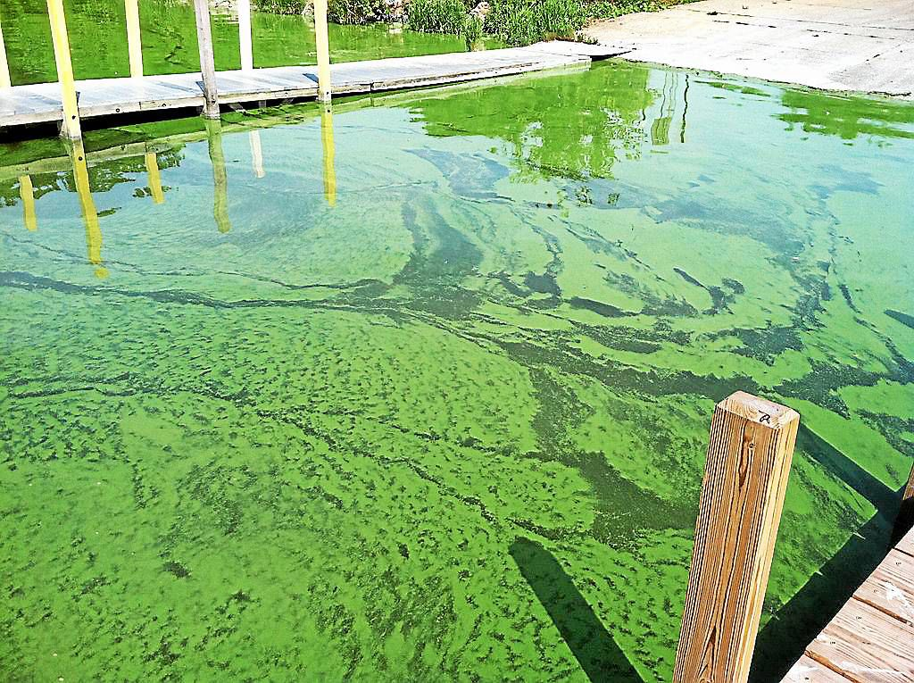
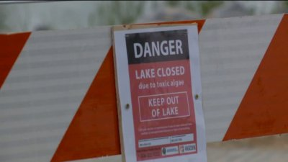

Slide 4
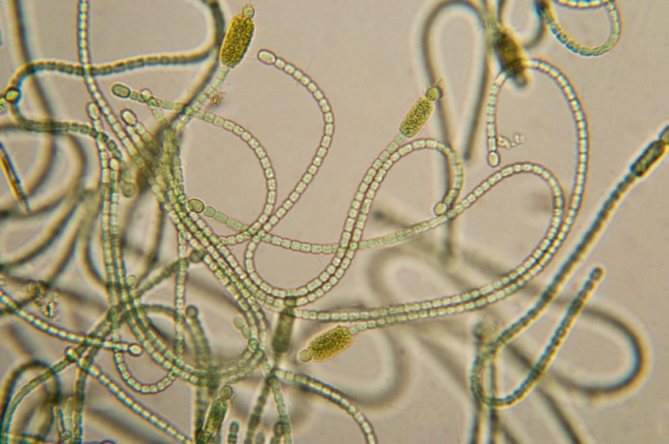
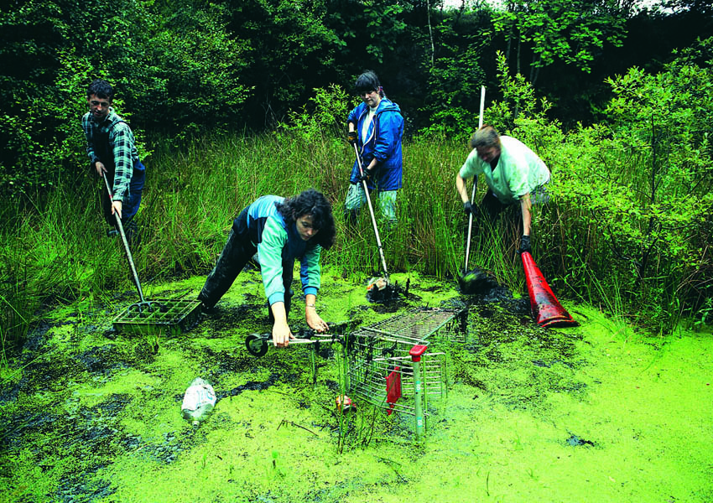
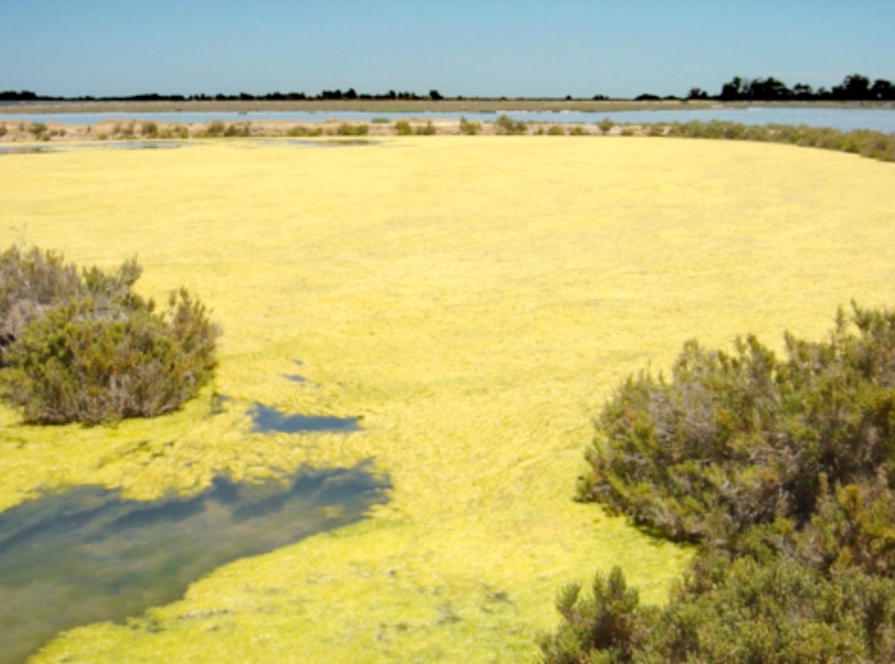
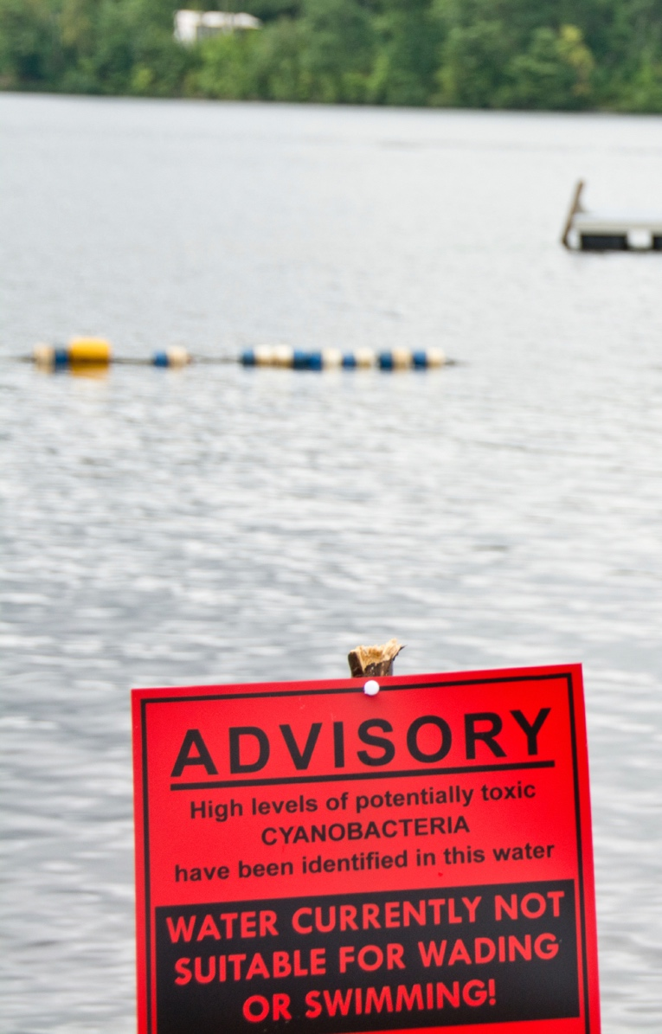
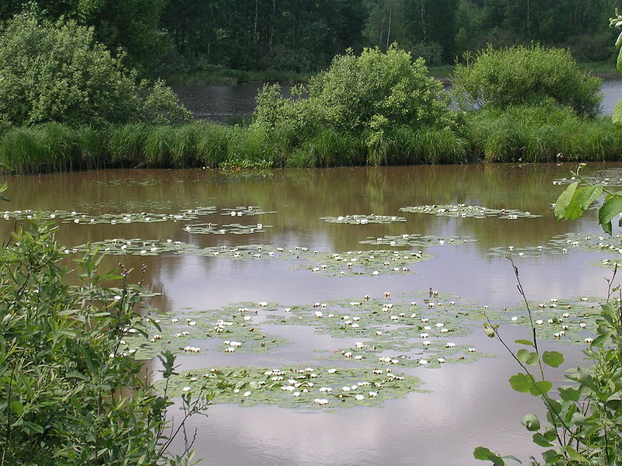
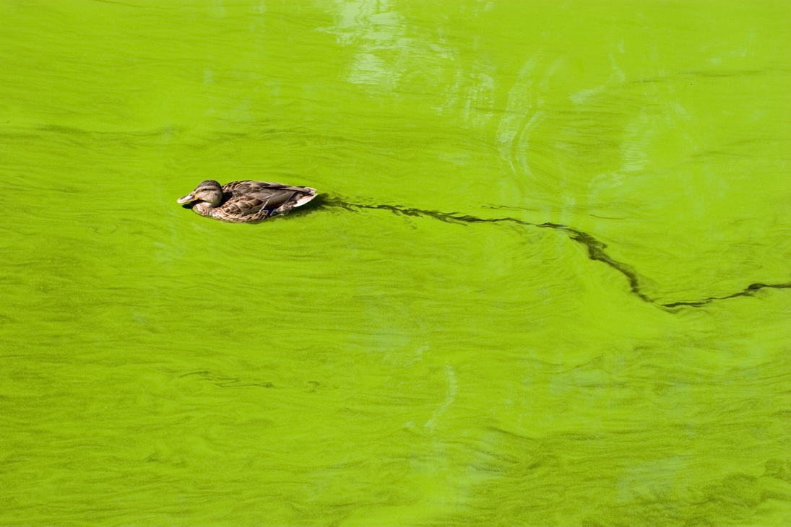

Slide 5
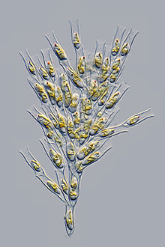
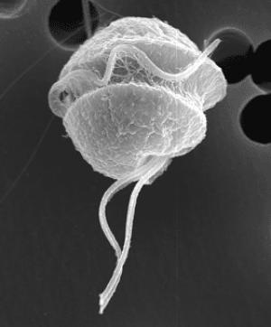
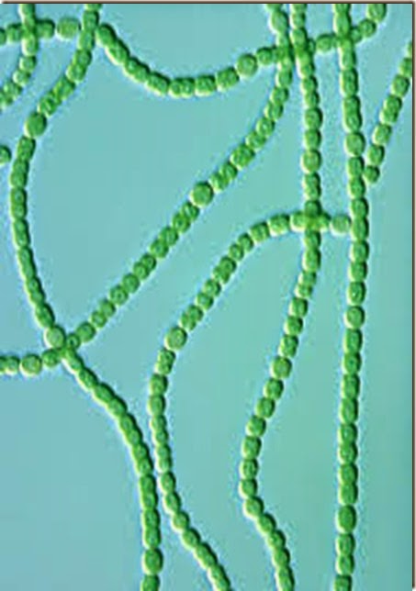
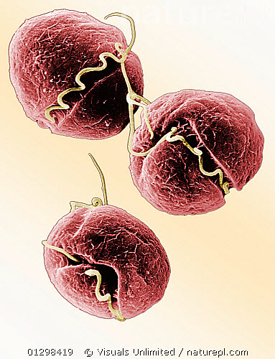
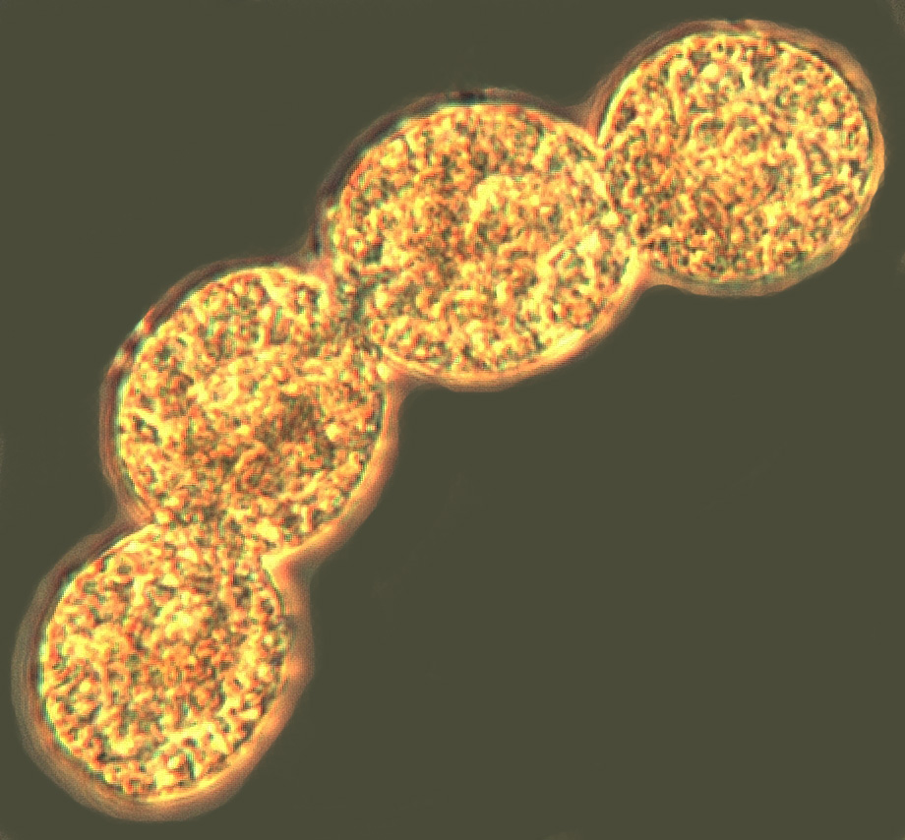
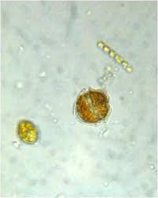
HAB Organisms Vary by Region
Dinoflagellate, Red tide, Karenia
Cyanobacteria, blue-green algae, Microcystis, Anabaena
Golden algae, Prymnisium
Brown tide, Aureoumbra
Orange tide, Noctiluca
Pfiesteria

Slide 6
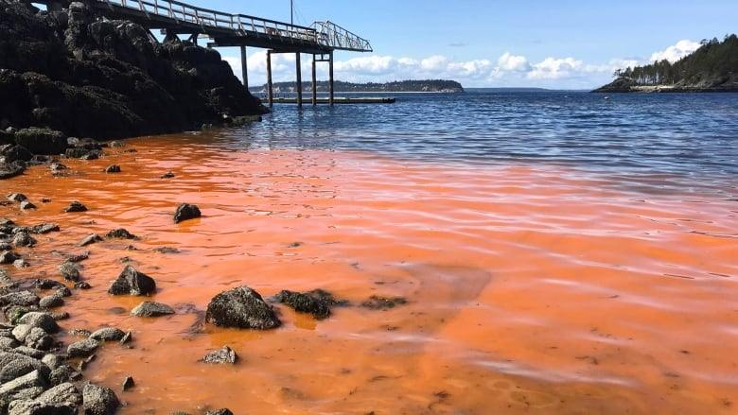
Harmful Algae Blooms Potential Impacts
Lead to oxygen depletion
Aesthetic water quality
  Visual
  Taste
Recreation
Commercial Fishing
Tourism
Harm to animals (toxins)
  Fish
  Wildlife and pets
  Humans

Slide 7
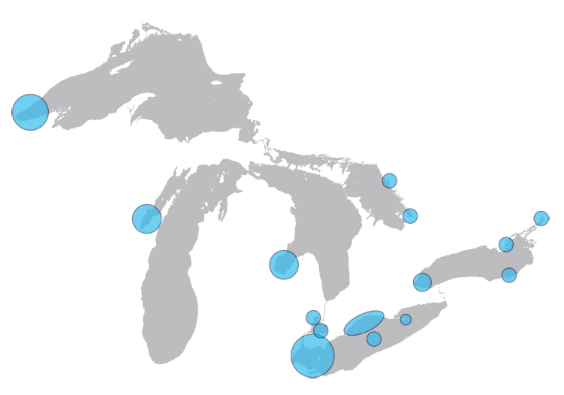
Known Areas of HABs in the Great Lakes
Lake Superior
Lake Huron
Lake Michigan
Lake Ontario
Lake Erie
Source: NOAA, GLERL, CIGLR, Sea Grant (https://www.glerl.noaa.gov/pubs/brochures/NOAA_HABs_in_Great_Lakes.pdf)

Slide 8
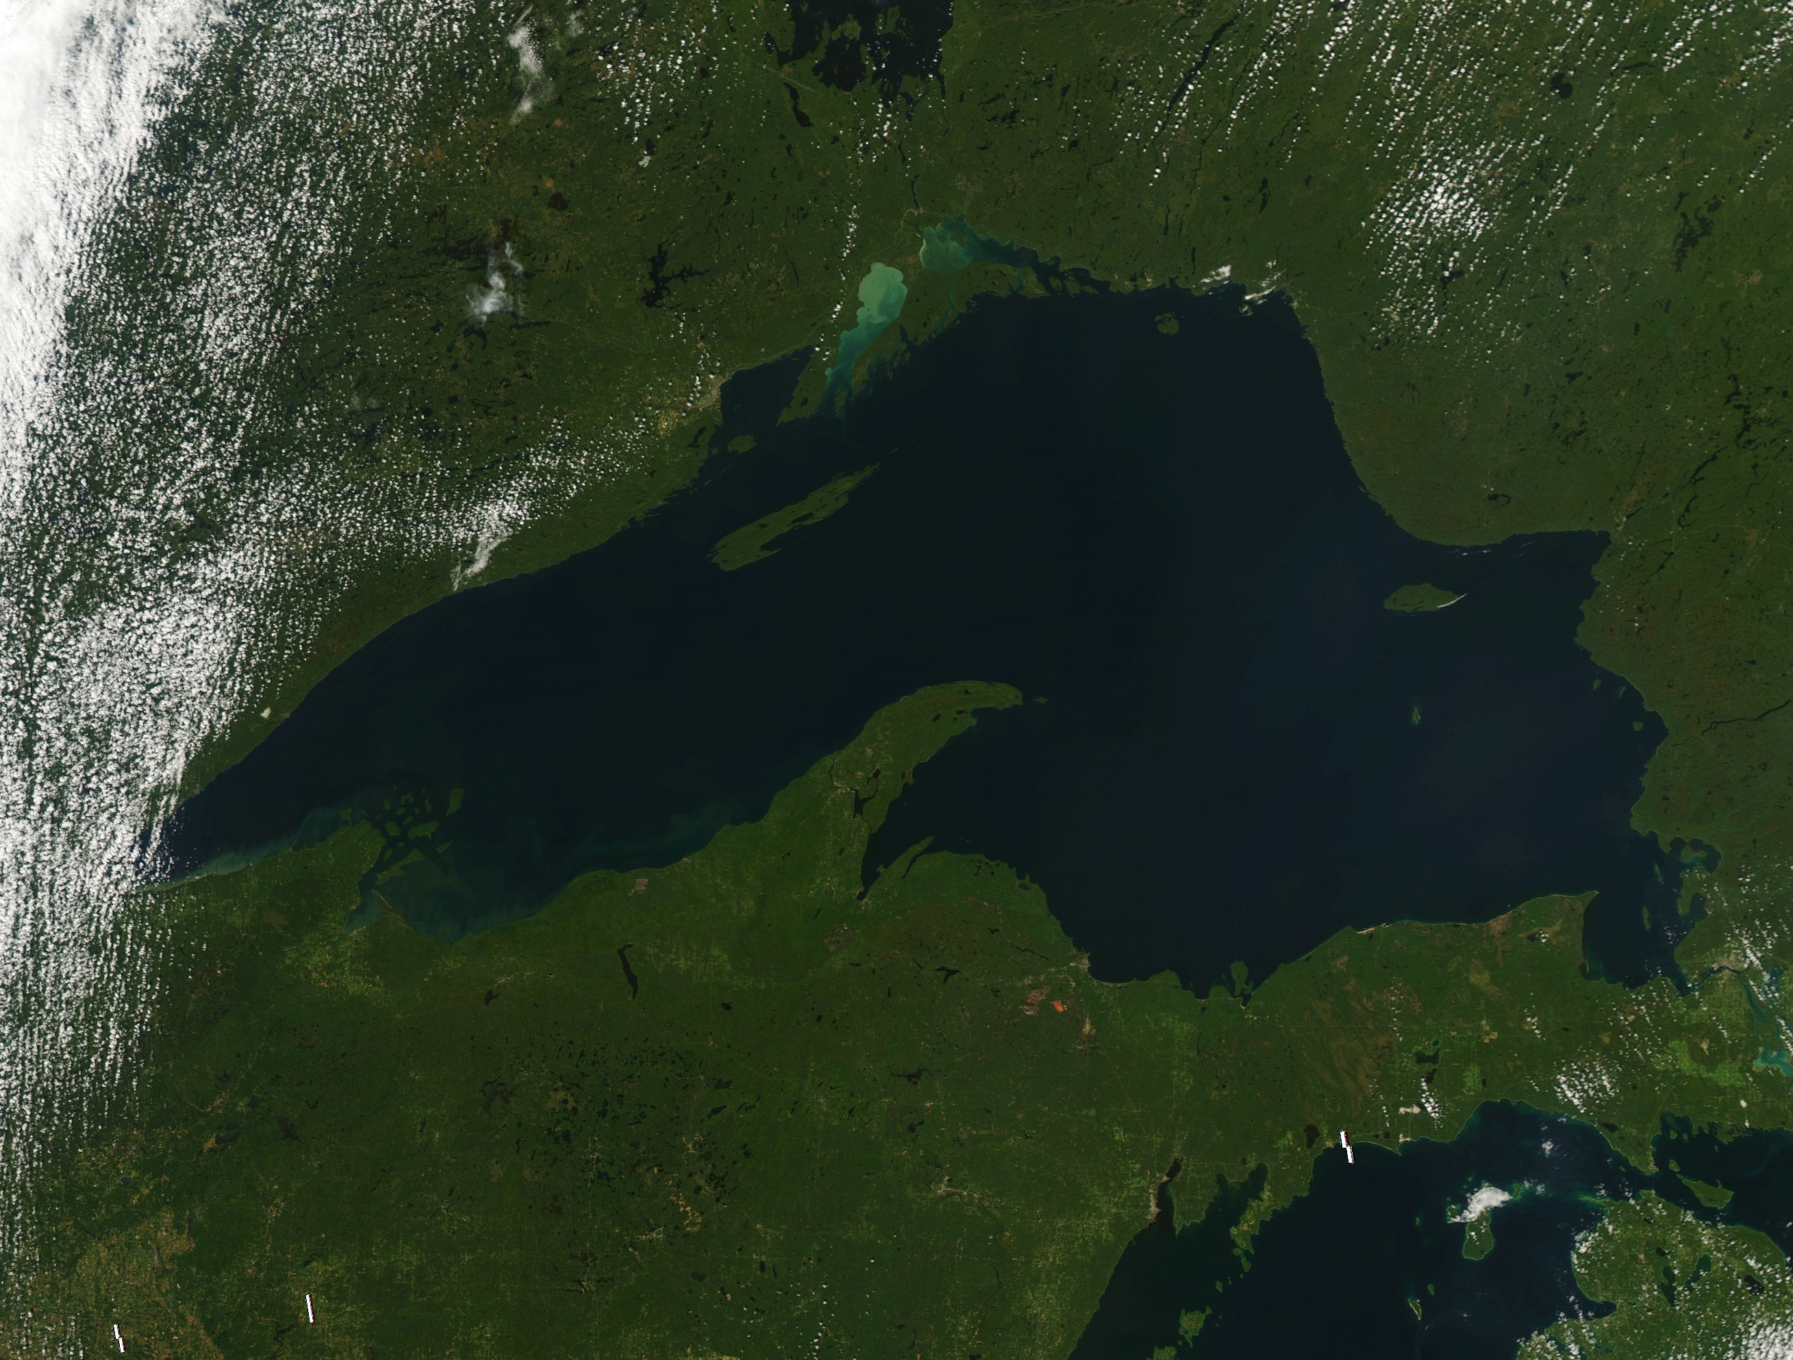
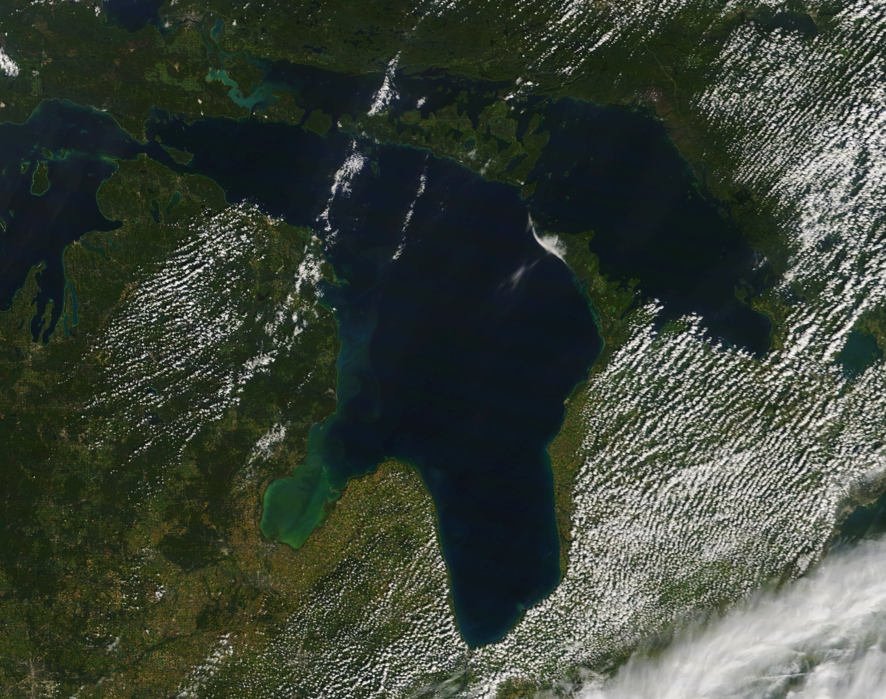
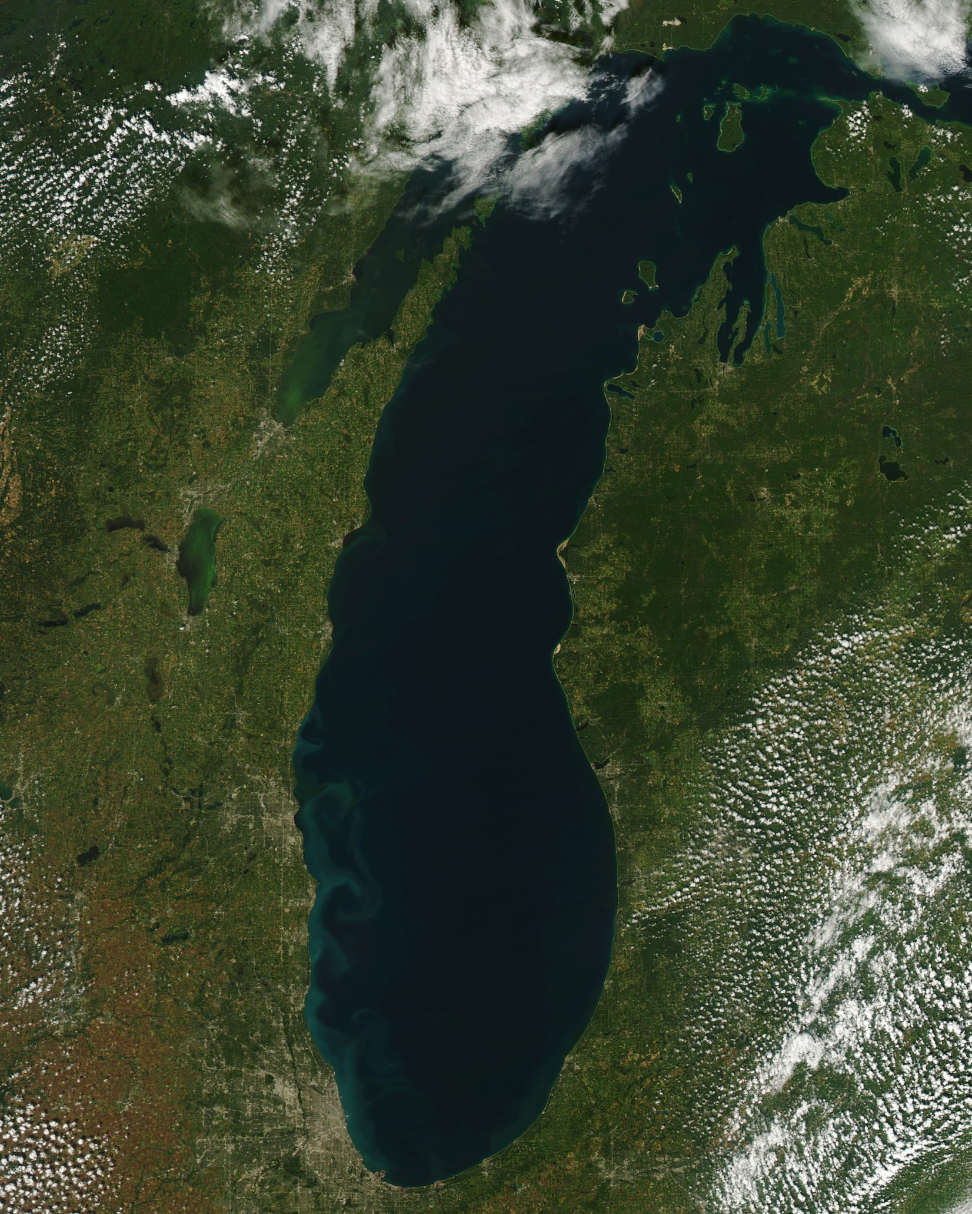
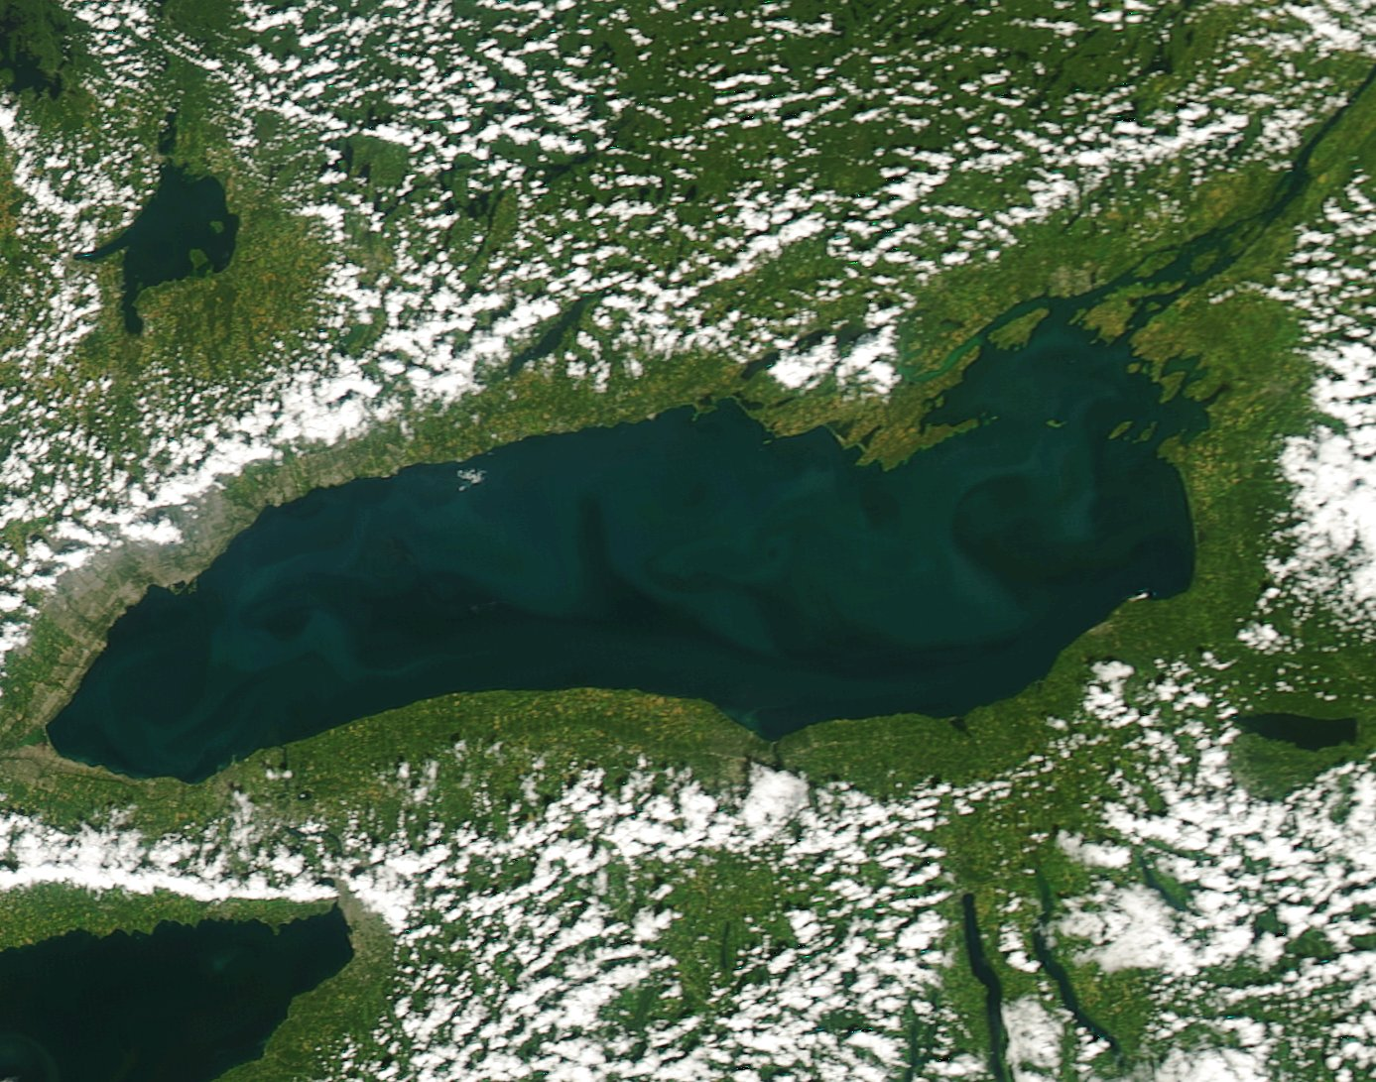
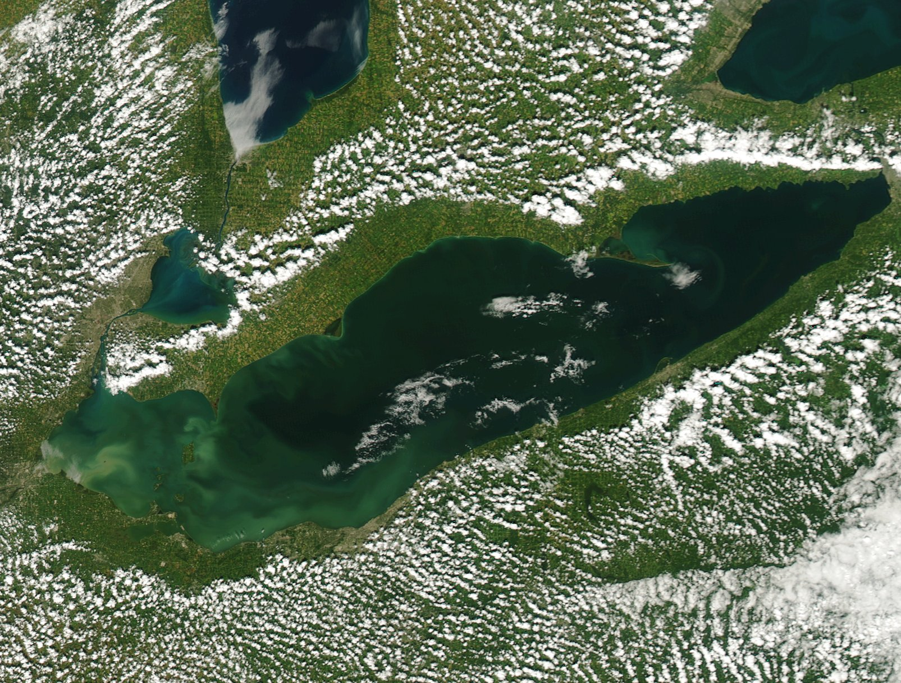
Current Satellite Imagery of the Great Lakes
Lake Superior
9/17/18
9/13/18
Lake Huron
Lake Michigan
Lake Ontario
Lake Erie
9/15/18
9/15/18
Source: NOAA’s Great Lake MODIS Imagery (https://coastwatch.glerl.noaa.gov/modis/region_map.html)
9/15/18
Notes:
These true color images were taken in mid-September and show sediment and algal blooms but those algal blooms may or may not be harmful. It depends on the species. As you can see, of all lakes, Lake Erie seems to have the largest area potentially impacted by algal blooms. Currently, there is still a bloom in western Lake Erie but it was not particularly strong this year as in past recent years and toxicity is low right now.
(Images are not from the same day because I selected those with the optimal lake visibility, i.e., least cloud cover).

Slide 9
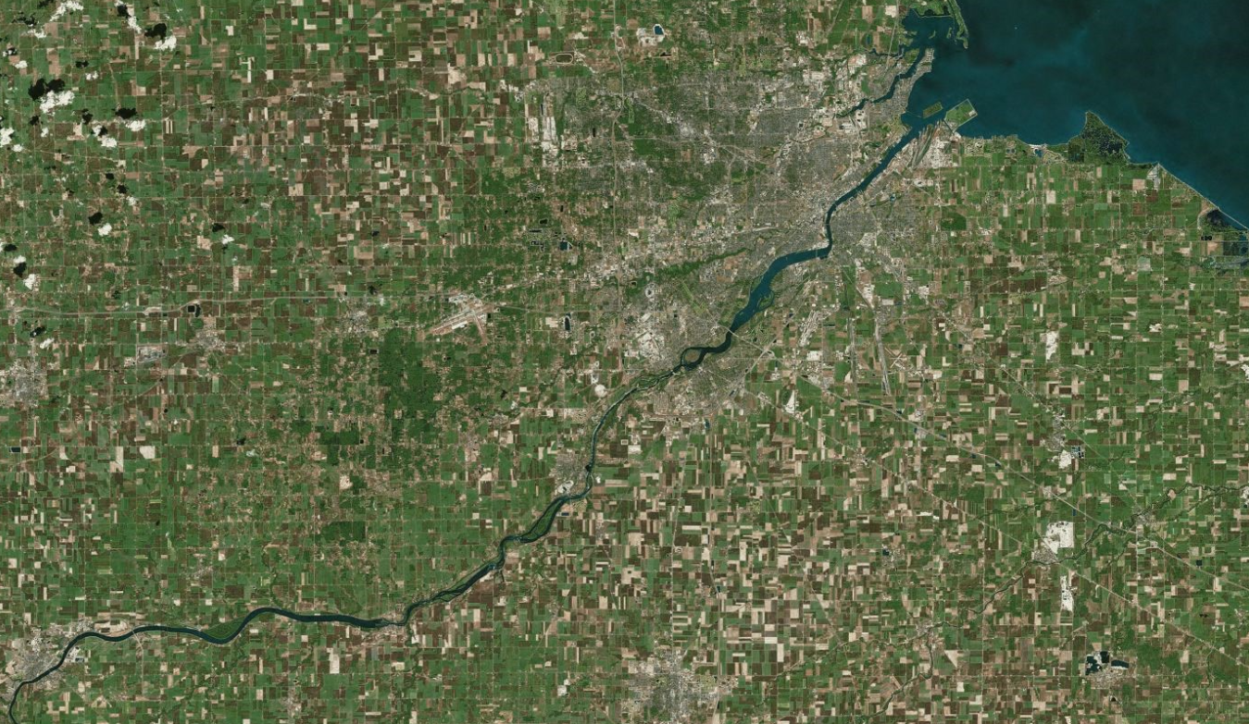
Why is Lake Erie Susceptible to Algal Blooms?
Shallowest, most southern lake
Nuisance algal blooms in 1960s and 1970s led to phosphorus load reductions
Algal biomass systematically increased since mid-90s
Increased agricultural lands in Maumee River watershed
Maumee River brings large sediment and nutrient load to west basin of lake
West Basin of Lake Erie
Portion of Maumee River
Bing

Slide 10
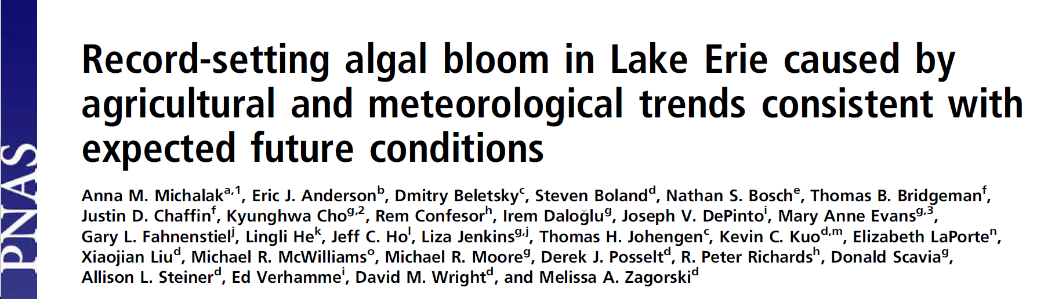
Lake Erie – Record Toxic Cyanobacteria Bloom in 2011
Due to increased dissolved reactive phosphorus (DRP) from long-term agricultural nutrient practices combined with large storm runoff events in early 2011 and weak circulation
3 conditions can enhance DRP
    Autumn fertilizer application
    Surface application instead of injection into soil
    Conservation tillage
Source: Fig 1. in Michalak et al. 2013
MODIS imagery shows bloom on 9/3/2011
Notes:
Autumn weather conditions in 2010 were ideal for completing harvest and preparing fields for the following year, increasing autumn application of fertilizer. The spring of 2011 then experienced a series of large storm runoff events between mid-February 17 and early June. While warm, quiescent conditions, which encourage bloom growth, were of lower frequency before the bloom, such conditions relative to other years did occur after bloom onset. In addition, weak circulation in the summer of 2011 compared to other years led to longer residence times.

Slide 11
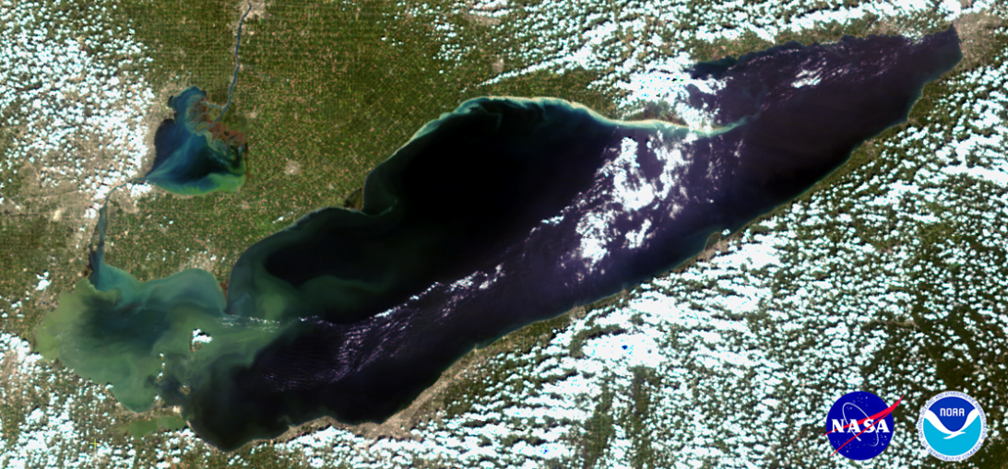
Lake Erie – 2014 Toledo Bloom Water Crisis
Cyanobacteria penetrated intake pipes
2-day ban on drinking and cooking with tap water
Affected >400,000 residents
Economic impact estimated $65M
MODIS imagery shows 2014 bloom in western basin near Toledo
(Source: https://www.noaa.gov/media-release/noaa-partners-predict-significant-summer-harmful-algal-bloom-for-western-lake-erie)

Slide 12
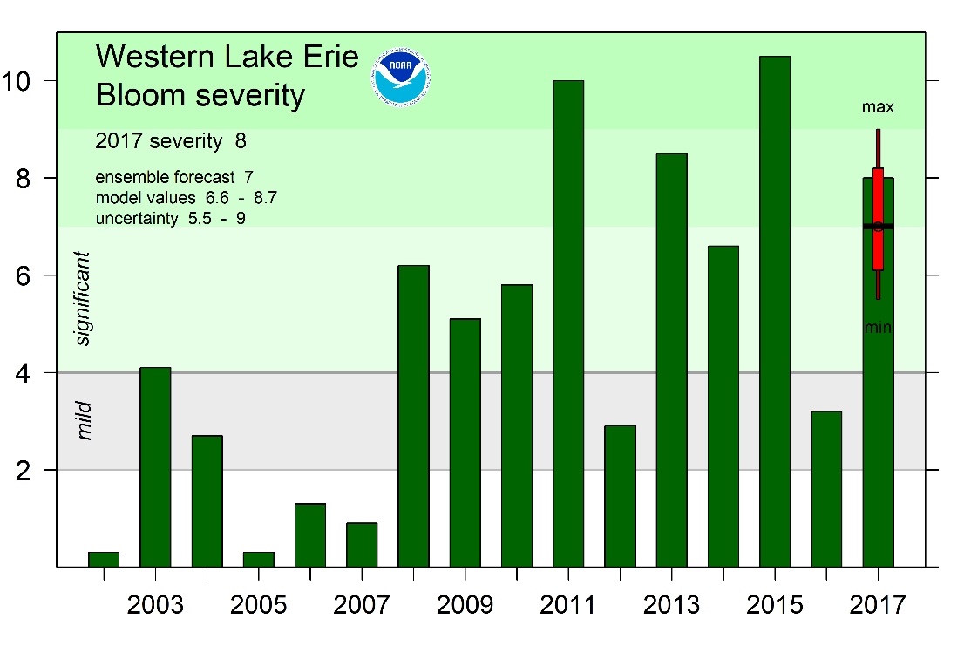
Lake Erie – Occurrence and severity of blooms
Severity based on size of bloom and Microcystis levels
2017 bloom was equivalent to 2013 bloom and third to blooms in 2011 and 2015
Source: http://lakeeriealgae.com/forecast/

Slide 13
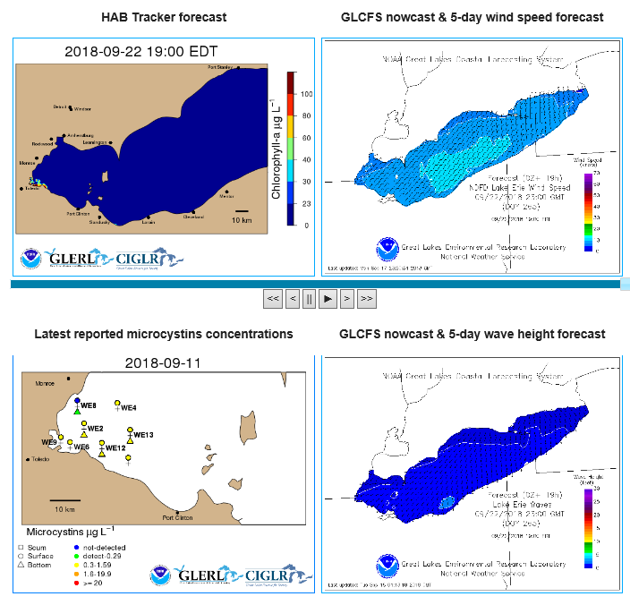
Lake Erie – Experimental HAB Tracker
NOAA GLERL and CIGLR
Forecast model similar to weather forecast
  Daily HAB and 5 day outlook
Uses satellite imagery, weather forecast, and modeled currents
Cyanobacterial index is developed
Helps to prevent future HAB emergencies, like 2014 Toledo Water Crisis
Source: https://www.glerl.noaa.gov/res/HABs_and_Hypoxia/habTracker.html
Notes:
GLERL = NOAA Great Lakes Environmental Research Laboratory
CIGLR = Cooperative Institute for Great Lakes Research (partners include UMich, Central Michigan Univ, MSU, Cornell, Ohio State, UWiscon, UMinn Duluth, UWindsor, Grand Valley State Uni, The Nature Conservancy, LimnoTech, Fondriest Environ., GLEC, Michigan Environ. Council)

Slide 14
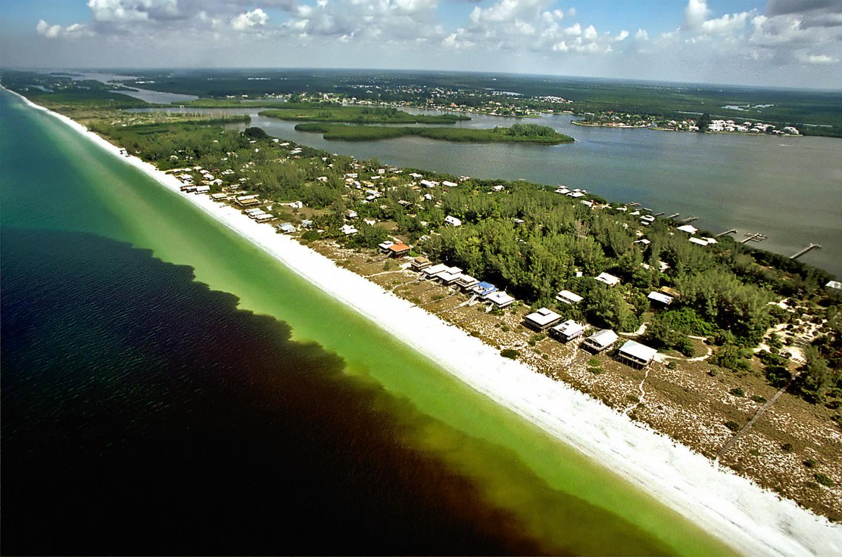
Red tides in the Gulf of Mexico
Outbreaks have occured on Texas shelf, West Florida Shelf
Toxic blooms can be hazardous to marine mammals, fish and humans
  Neurotoxic poisoning to many organisms
  Aerosolized toxins can cause respiratory illness in many mammals including humans
Red tide along West coast of Florida. P.Schmidt, Charlotte Sun

Slide 15
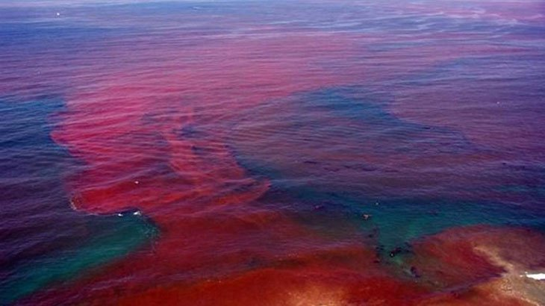
Red tides in the Gulf of Mexico
Exact causes are still unknown, despite extensive and active research
May be a “perfect storm” event
  salinity
  temperatures
  light saturation
  chemistry
  currents
  all conspire to produce a bloom in offshore waters that may be blown to shore by the wind
Red tides (Photo credit: The Online Fisheman)
Notes:
Red tides bloom offshore and move toward land with water currents

Slide 16
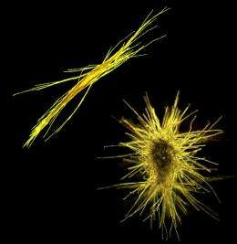
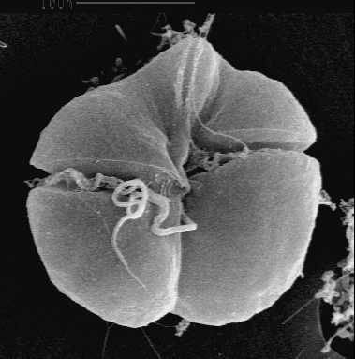
Karenia brevis
N₂ from atmosphere
Most significant red alga species
Dinoflagellate
Capable of acquiring nitrogen from organic compounds
  Cyanobacterial blooms fix N₂ from the atmosphere, then release dissolved organic nitrogen
  This dissolved organic nitrogen is a source of nitrogen for K. brevis
  Because of this, many blooms are not monocultures.
Release organic nitrogen
Trichodesmium
(cyanobacteria)
Abby Heithoff, Woods Hole Oceanographic Institution
Karenia brevis
Florida Fish and Wildlife Conservation Commission
Notes:
Most phytoplankton species acquire nitrogen from inorganic compounds. Fertilizers contain inorganic N.
Karenia brevis out-competes other organisms when dissolved organic nitrogen is present

Slide 17
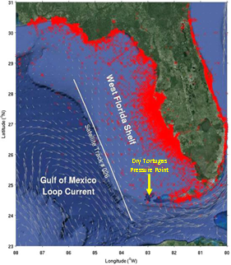
Bloom origins
Initiation and development of K. brevis blooms in open waters seem to be supported by sources within the aquatic food web
In localized nearshore areas, land-based nutrients and sediments may be a contributor of a portion of the nutrients that sustain the blooms
Locations of observations of Karenia brevis cell counts (red crosses) in the Florida coastal region from 1953–2015. University of South Florida
Notes:
Sources within the aquatic food web: cyanobacteria blooms, also dead fish
Anderson et al. (2008). Harmful algal blooms and eutrophication: Examining linkages from selected coastal regions of the United States

Slide 18
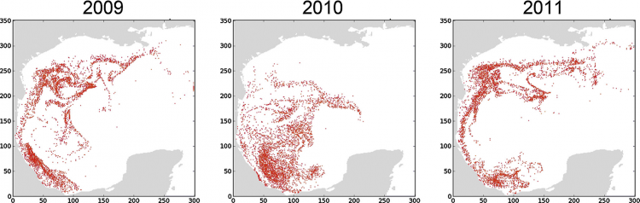
Bloom origins: Example of research
Model of K. brevis blooms on Texas shelf
K. brevis cells near the Texas coast during early fall originated from
  the southern Gulf of Mexico in bloom years
  the northern Gulf of Mexico in the non-bloom year
Simulated distributions of individual cells after 60 days from a single model run in forward time for each year highlight the differences between Texas bloom years (2009, 2011) and the Texas non-bloom year (2010). Each red dot represents a single individual cell from the model. Credit: D. Henrichs, R. Hetland, and L. Campbell, Texas A&M University.
Notes:
Identifying a southern origin for bloom-forming cells provides a target area for increased sampling to provide early warning of potential blooms of K. brevis.
https://coastalscience.noaa.gov/news/origin-toxic-red-tides-texas-identified/

Slide 19
Links to hurricanes
According to NASA scientists, Florida's very active 2004 hurricane season may have played an important part in the development of extensive and long-lasting red tide conditions that affected its coastal areas in 2005
Several factors from 2004 hurricanes may have contributed to the 2005 red tide
  heavy rain
  runoff
  submarine (below the ocean floor) groundwater discharge
Notes:
During the 2004 hurricane season, four hurricanes crossed the state of Florida: Charley, Frances, Ivan and Jeanne.
https://www.nasa.gov/centers/goddard/news/topstory/2006/hurricane_redtide.html

Slide 20
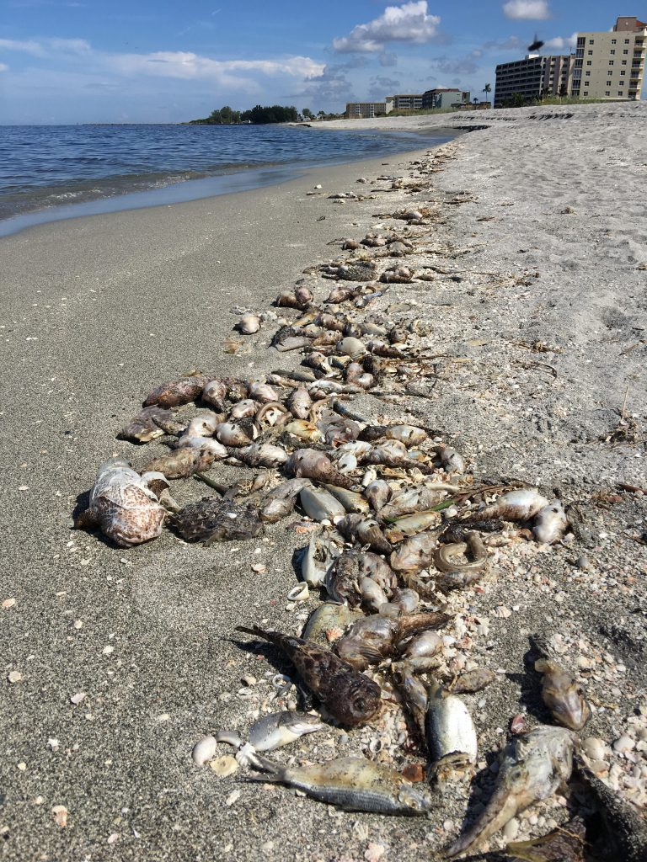
Ongoing red tide along western coast of Florida
A Karenia brevis bloom currently extends over 100 miles along Florida’s southwest coastline
The bloom originated offshore in October 2017
The red tide intensified and moved closer to shore in June 2018, extending 130 miles and affecting seven Florida counties
Dead fish on beach near Sarasota, Florida, killed by toxins from 2018 red tide. Credit: Bob Currier, Texas A&M University
Notes:
While red tide blooms commonly occur off Florida’s west coast between late August and November, this bloom is larger and formed earlier than usual, and has remained close to shore for several weeks.

Slide 21
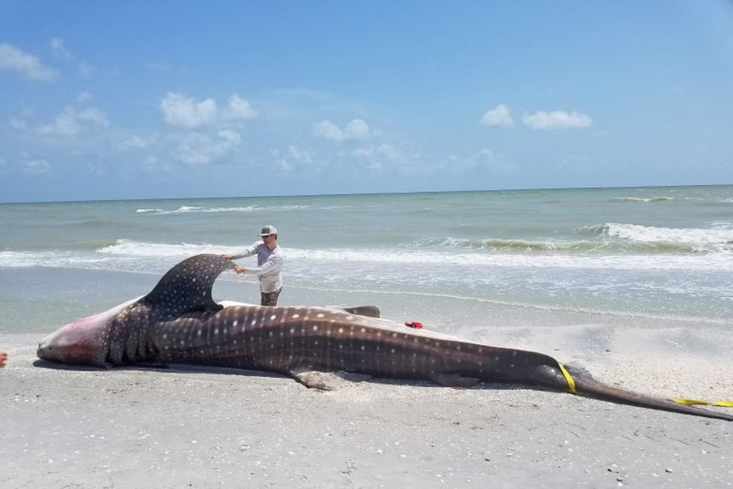
Ongoing red tides – links to hurricanes?
Hurricane Irma blew through Florida in 2017, which led to massive runoff that perhaps is driving this latest bloom
Hurricane Harvey hit Texas in 2017; a localized red tide bloom has been observed along Padre Island National Seashore, starting in September 2018
Dead whale shark that washed ashore on Sanibel beach on July 27, 2018. Florida Fish and Wildlife Conservation Commission.
Notes:
While red tide blooms commonly occur off Florida’s west coast between late August and November, this bloom is larger and formed earlier than usual, and has remained close to shore for several weeks.
Richard Bartleson, a biologist at Sanibel-Captiva Conservation Foundation (SCCF). https://www.nationalgeographic.com/environment/2018/08/news-longest-red-tide-wildlife-deaths-marine-life-toxins/
https://kristv.com/news/local-news/2018/09/14/pins-tpwd-monitoring-red-tide-levels-in-area-waters/

Slide 22

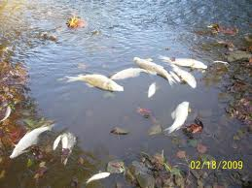
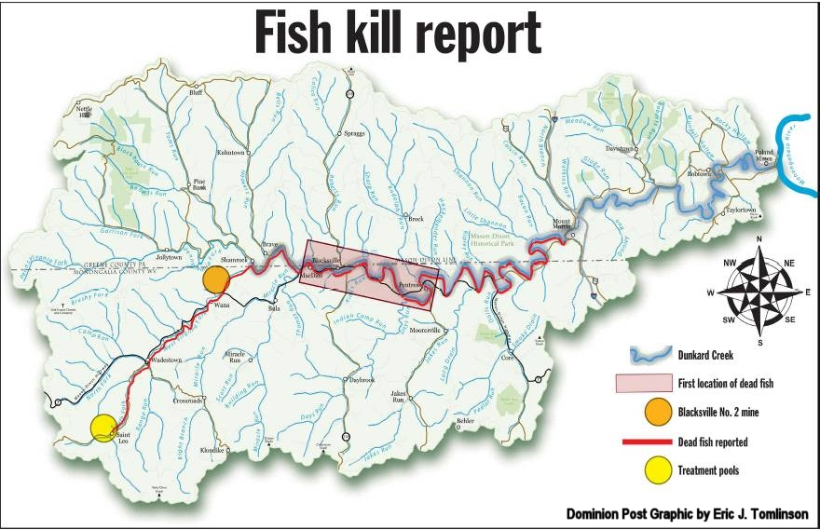
Dunkard Creek, Pennsylvania
Bloom of the estuarine/marine golden algae
30-mile impact of Creek, fish kill
Minnows, bass/sunfish, muskellunge, mussel, mudpuppies
Impacted major sport fishery

Slide 23
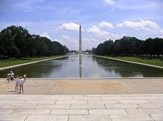
Department of Interior, Park Service
Several years ago, received a call for help on removing algae from the Lincoln Memorial Reflecting Pool
In 8 days, they were going have a dedication of the redesigned reflecting pool
Large bloom of green, cyanobacteria and filamentous algae

Slide 24
Characterization
Management
Mitigation
Slow Physiological Response
High Biomass Response
Maximum Impacts
Rapid Physiological Response
IMPACTS
Easy to Assess
Difficult to Remediate
Ecosystem Response
IMPACTS
Difficult to Assess
Easy to Remediate
Minimal Impacts
Nutrient Loading

Slide 25
Summary
Changing environmental factors
  Increasing temperatures
  Increasing amount of extreme weather events
Harmful algae blooms have been going on for a long time in the US historic record, dated as early as 1609.
However, limited research on causes of HAB, often only antidotal observations
Many HABs are most active in summer, low-flow periods
Current management has been focused on characterization of blooms and treatment by filtration/separation of algae cells from water column

Slide 26
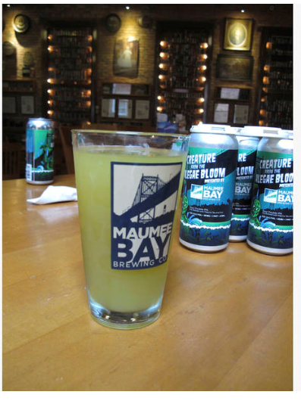
Lake Erie Toxic Blooms Inspires Ohio Brewery
Sour double IPA called “Ale’gae Bloom”
Raise awareness about toxic algae in Lake Erie
Ale contains green tea and kiwi
Source: Toledo Patch (https://patch.com/ohio/toledo/toxic-algae-lake-erie-inspires-ohio-brewers-green-beer); September 18, 2018

Slide 27
Thank you, are there any questions?

