Slide 1
Protecting Illinois’s Environment
The Illinois Environmental Council has served as the eyes, ears, and voice of the environmental community in Springfield since 1975.
ILEnviro.org | @ILEnviro

Slide 2
The Illinois Environmental Council was started in 1975 to represent environmental organizations in front of the General Assembly - essentially, serves as a trade association.
80 Affiliate Organizations
Range from international to hyper-local
Policy areas of interest include energy, water, land use and agriculture, wildlife
Mission
To ensure a healthful environment for all Illinoisans.

Slide 3
Lead Affiliates
Center for Neighborhood Technology
Citizens Utility Board
Clean Energy Trust
Elevate Energy
Environmental Defense Fund
Environmental Law and Policy Center
Faith in Place
Illinois Solar Energy Association
Izaak Walton League of America, Illinois Division
Midwest Energy Efficiency Alliance
Natural Resources Defense Council
Openlands
Prairie Rivers Network
Respiratory Health Association
Sierra Club, Illinois Chapter
The Nature Conservancy, Illinois Chapter
Full list of affiliates here:
ilenviro.org/iec-affiliates

Slide 4
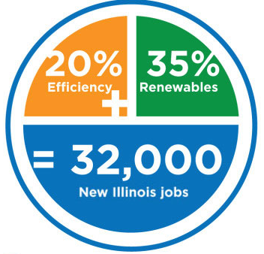
Composed of energy/environmental advocates, businesses, consumer groups, labor unions, faith groups, public health organizations.
What do we want?
Our focus was to make sure that any energy legislation included strong provisions for renewable energy and energy efficiency, as well as make these things available to people who historically have not had access to them.

Slide 5
Global Warming is...
Happening: 73% (+2 Natl Avg)
Mostly Caused by Human Activities: 56%
Regulate CO2: 78%
CO2 limits on existing coal-fired power plants: 74%
Require Utilities get 20% electricity from RE: 68%

Slide 6
Clean Jobs Reports
In Illinois…
113,918 Jobs
Highest clean energy jobs number in the Midwest
By sector:
78.8% Energy Efficiency
11.3% Renewable Energy
5.57% Advanced Transportation
3.05% Clean Fuels
1.23% Advanced Grid
Map
Other Resources:
Environmental Entrepreneurs (E2)
Includes state-specific reports from CA, CO, MO, NV, NY, OR, PA & TN
CleanJobsMidwest
Includes IA, IL, IN, KS, MI, MN, MO, ND, NE, OH, SD & WI
Business Profiles

Slide 7
Clean Energy Jobs Act
SB2132(Castro) / HB3624(Williams) are organized around four pillars:
Promoting Jobs and Economic Opportunity
Creates the Clean Jobs Workforce Hubs, a network of frontline organizations that provide direct and sustained support for minority and disadvantaged communities.
Putting Illinois on a path to 100% renewable energy by 2050
Builds more than 40 million solar panels and 2,500 wind turbines across Illinois by 2030, generating more than $30 billion in new infrastructure in the state.
Reducing the equivalent of 1 million gasoline and diesel-powered vehicles from the road
Empowers local communities to develop Community Energy and Climate Plans, to drive comprehensive local investment in energy, transportation, workforce, and environmental projects.
Achieving a carbon-free power-sector by 2030
Directs the Illinois EPA to begin a comprehensive stakeholder process that prioritizes carbon reductions in impacted communities and reduces harmful pollution from power plants to zero by 2030.

Slide 8
Flint Drinking Water Crisis
In 2014, Flint switched its water source to the Flint River because of financial issues with its water department.
The water from the Flint River was 19 times more corrosive than water from Lake Huron, its previous water source.
Lead levels were found above 5,000 ppb, which is considered hazardous.

Slide 9
HB3035
Legislation Summary:
​This bill would require municipalities and private water utilities to replace all lead service lines, with a focus on high priority environmental justice areas. This bill would also place stringent requirements on communities to reduce water loss, a symptom of crumbling infrastructure that is very costly for ratepayers.

Slide 10
Clean Energy
Resource- Efficient Cannabis — HB1438 (Steans/Cassidy) IEC worked with legislators to add new Illinois specific, nation-leading standards and administrative framework to this bill that help mitigate some of the negative impacts that would otherwise result from expanding the cannabis industry in Illinois. The inclusion of our proposal makes this the “greenest” cannabis bill in the nation. This bill passed 38-17-2 in the Senate and 66-47 in the House.
Taking Action on Climate Change — HB3481 (Gabel/Ellman) By removing a provision in existing statute, this bill authorizes Illinois to take action on climate change by regulating greenhouse gases. This vote on this bill demonstrates a pro-climate action majority for the first time in both chambers. It is the first stand alone climate bill to receive a majority roll call and move to the governor. HB3481 passed 66-44-1 in the House and 36-17 in the Senate.
Coal Ash Pollution Prevention Act — SB9 (Bennett/Ammons) IEC, along with many of our partners, heavily negotiated this major legislation to protect clean water and public health. This bill creates a regulatory framework to ensure polluters, not taxpayers, pay for needed closure and cleanup, guarantees public participation and transparency, and provides Illinois EPA the funds it needs to properly oversee closure and cleanup. SB 9 pass 77-35-1 in the House and 39-9-7 in the Senate.

Slide 11
Clean Energy
Dirty Industry Bill–HB1633 (Hoffman/Hastings) This was an ALEC bill that protected new pollution projects from criticism and enhanced penalties on criminal actions already illegal in Illinois. Sen. Hastings heard the concerns and demonstrated the courage to stand up against the bill, stopping it from advancing. HB1633 passed 77-28-3 in the House but was tabled in the Senate.
Solar and EV Ready Construction — HB2652 (Halpin/Belt) This legislation will allow expansion of building codes to include solar, electric vehicle and other supplemental codes. HB2652 passed 112-1 in the House and 54-0 in the Senate.
Solar Opportunities for Universities — SB211 (Bennett/Stuart) This legislation addresses regulatory barriers to university procurement of solar and wind power. An initiative of SIU, this will increase the length of time that a university can use to pay back wind and solar power purchases. SB211 passed 49-0 in the Senate and 108-8 in the House.
County Wind Development — HB2988 (Williams/Cunningham) This bill clarifies current law by making it even more explicit that only counties and municipalities have zoning authority over wind farm development. This change will facilitate wind development to facilitate growth, as it has since 2007, under the regulatory oversight of the county and municipal governments in Illinois. HB2988 passed 43-7-1 in the Senate and 95-12-1 in the House.

Slide 12
Conservation
Wrongful Tree Cutting — HB3105 (Edly-Allen/Stadelman) This legislation fairly compensates owners of protected lands who have suffered damages from illegal logging. HB3105 passed 113-0 in the House and 53-0 in the Senate.
Conservation Easements — HB2601 (Morgan/Bush) Makes changes to the law on conservation easement to encourage greater flexibility in protecting open space and conservation areas. HB2601 passed 56-0-1 in the Senate and 97-0 in the House.
Removing Endangered Species Protections — HB2425 (Chesney) We were able to stop HB2425/SB1336, bill that jeopardize endangered species by eliminating certain requirements for permits, notice and public hearings. This bill would have left the protection of federal endangered species in the hands of the Trump administration, as they actively rolling back protection of endangered species. HB2425 was held with a vote of 60-47-3 in the House.

Slide 13
Sustainable Agriculture
Promoting Soil Health — HB2737 (Halpin/Bennett) The Soil Water and Conservation Districts (SWCDs) are an important resource for farmers in Illinois. This legislation adds soil health practices to the list of resources that SWCDs can provide for farmers. The bill passed the House 112-0 and 59-0 in the Senate.
Enhancing Local Food Opportunities — HB2505 (West/Fowler) In redefining the definition of “local”, this bill will improve opportunities for the state to purchase local food. This bill passed unanimously out of both chambers. 112-0 in the House and 56-0 in the Senate
Supporting Nutrient Loss Reduction Goals — SR52 (Bennett) This resolution calls for the state to support the Nutrient Loss Reduction Strategy.

Slide 14
Water
Microplastics — SB1392 (Morrison/Batinick) With the growing threat of plastics in our water and our food sources, IEC introduced legislation that requires a study of the threat of microplastics and opportunities for regulatory and legislative protections. The bill passed 118-0 in the House and 57-0 in the Senate.
Equitable Water Rates — SB1724 (Harris/Ford) This legislation requires that the University of Illinois-Chicago study the setting of water rates in northeastern Illinois. Subject to appropriation, the study will take into consideration factors when setting rates, challenges for low-income communities and opportunities for greater collaboration and equity. This bill passed the House 108-8 and 49-0 in the Senate.
Creating Water Infrastructure Jobs — SB2146 (Villivalam/Slaughter) This bill will create funding and resources for water jobs training programs and those from disadvantaged communities that are placed in them. As of writing, this bill has not yet passed the Senate, but is expected to do so today. The bill passed the House 103-11 and will have a concurrence vote in the Senate today.
Dirty Industry Bill–HB1633 (Hoffman/Hastings) To ensure that state revolving funds for water infrastructure can be used broadly by communities, this bill will set forth a rulemaking by IEPA to clarify the use of SRF for ‘set-aside’ programs, such as consolidation. Passed the House 108-0 and the Senate 56-0.

Slide 15
Waste
State Action on Waste — HB3068 (Costa-Howard/Ellman) This bill will require the state to develop a comprehensive plan to address solid waste. This legislation also provides for the establishment of recycling programs at state agencies with specific goals around waste reduction. 104-6 in the House and 54-0 in the Senate.
Bulk Containers — HB3440 (Guzzardi/Steans) This legislation will cut down waste by ensuring that retailers may offer the use of personal containers for bulk foods. This clarifies uncertainties surrounding this issue and prevent municipalities from unnecessarily banning the use of personal containers in the future. 91-6 in the House and 54-0 in the Senate.

Slide 16
Toxics
Ethylene Oxide — SB1852/SB1854 (Durkin/Curran, Mason/Bush) IEC worked with Senators Curran and Bush, and Representatives Durkin, Mason, and Yingling to craft legislation that strengthens protections against ethylene oxide. SB1852 regulates sterilization facilities such as Sterigenics and Medline, the two biggest emitters in the state. It provides a pathway to keep bad actors such as Sterigenics closed and lowers the emissions level of Medline to the lowest permitted emissions in the country. SB1854 is a step towards regulating Vantage, a manufacturing company that emits a large level of ethylene oxide, by requiring emissions monitoring, dispersion modeling, and giving the IEPA the ability to reopen and cap their emissions permit. SB1852 passed the House 108-0-1 and the Senate 53-0. SB1854 passed the House 90-17 and the Senate 55-1.
BPA Receipts — HB2076 (Villa/Gillespie) BPA (bisphenol A) is an industrial chemical that has been used to make certain plastics and has been found to be a threat to human health. Some retail establishments still use receipt paper that is made with BPA, presenting a risk to both the workers and customers. This bill prohibits the manufacture and distribution of paper with BPA for the purpose of banking and business records. Passed the Senate 51-0 and the House114-0.
EJ Permit Notice — SB1847 (Munoz/Mah) IEC supported legislation this session that requires enhanced notice and opportunities for public participation for air permits within environmental justice communities. SB1847 passed the Senate 47-0 and the House 101-11.

Slide 17
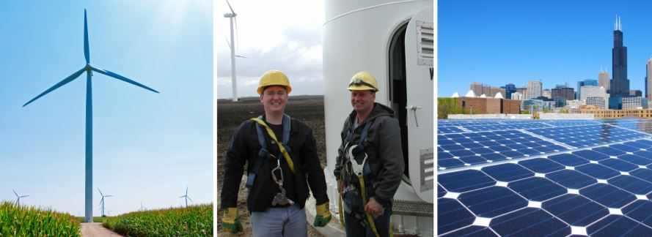
Thank you!
Jen Walling jwalling@ilenviro.org
To learn more about IEC,
Sign up for our newsletter at our website ilenviro.org
Follow us on Twitter and Facebook @ilenviro

