Slide 1
Fox River Study Group Partnering to Keep on Fix'n the Fox River
Dr. Cindy Skrukrud
Clean Water Program Director, Illinois Sierra Club
Chair, Fox River Study Group

Slide 2
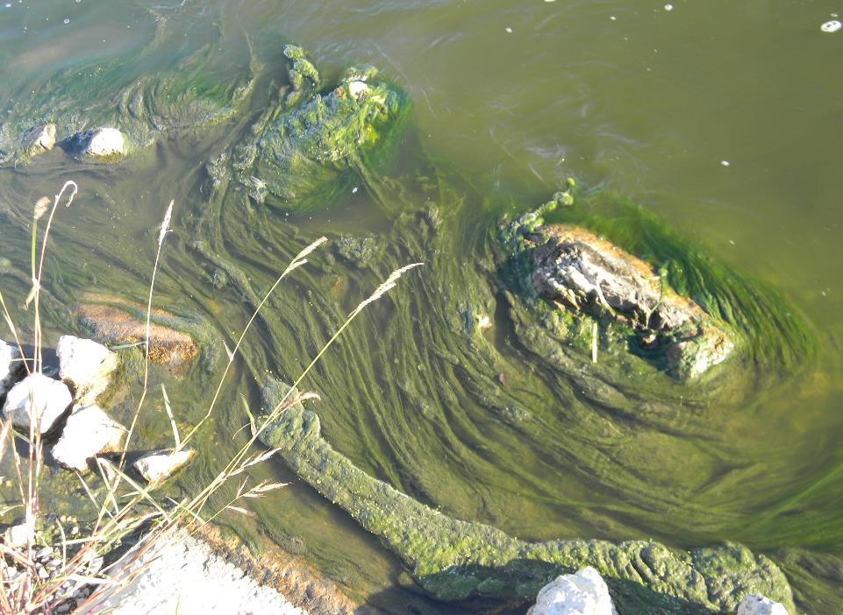
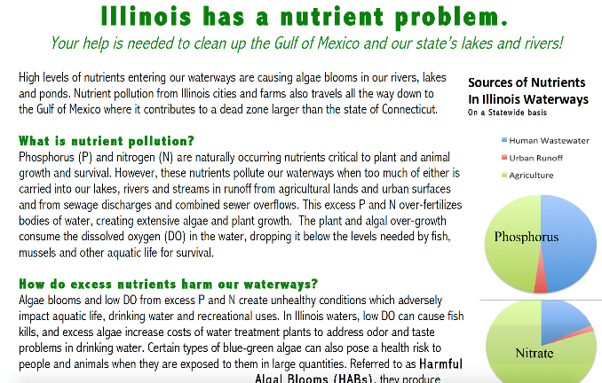
Illinois has a nutrient problem

Slide 3
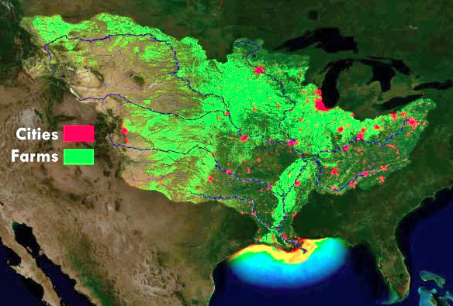
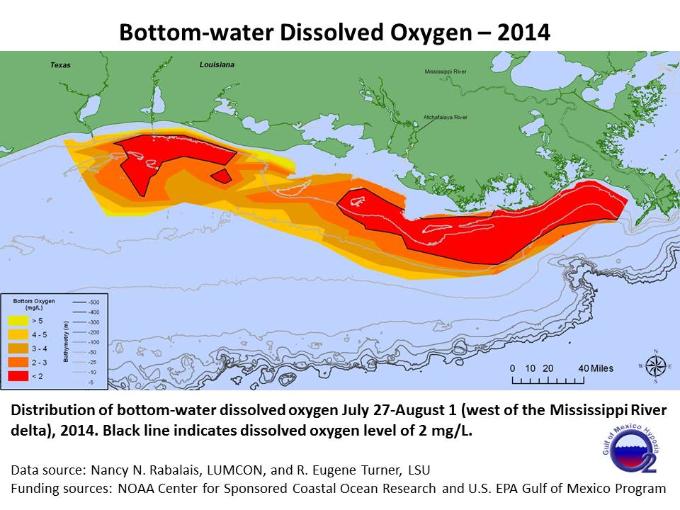
As does the Gulf of Mexico…

Slide 4
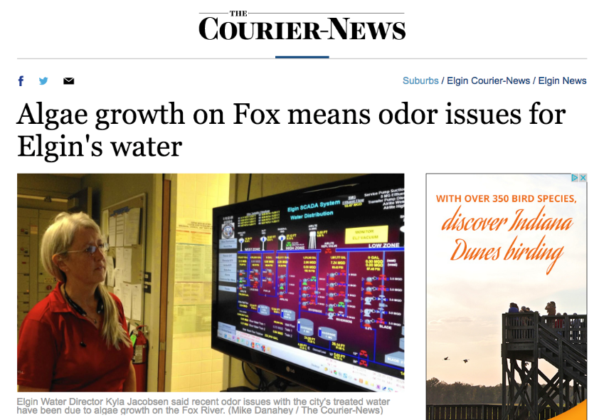
….And the Fox River too.

Slide 5
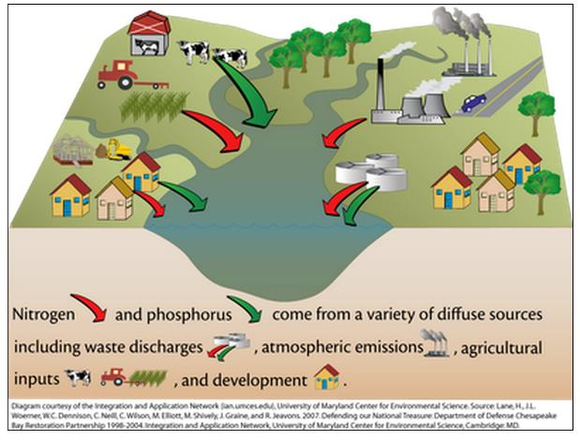
How excess fertilizer gets into our waters
Sources
Agricultural runoff
Wastewater discharges
Urban runoff
Combined sewer overflows

Slide 6
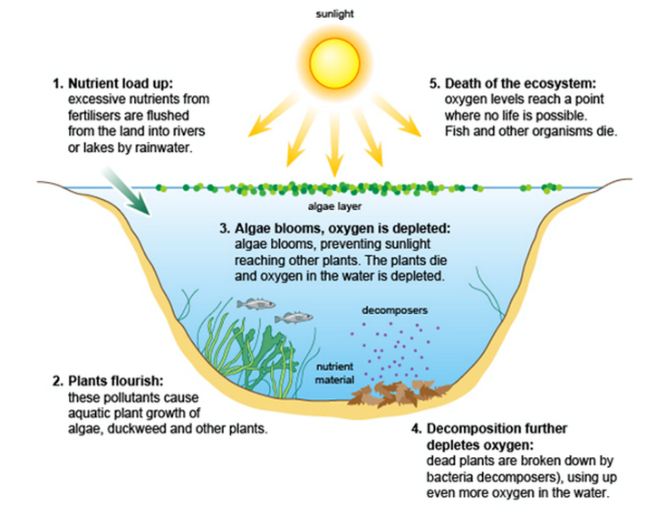
How over-fertilization affects bodies of water
Can you say Eutrophication?
Hypoxia?

Slide 7
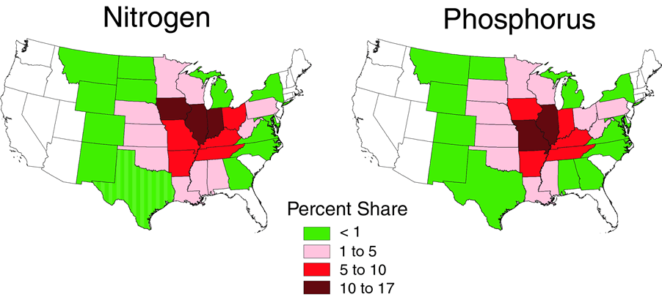
Nutrient Contributions to Gulf of Mexico
map

Slide 8

Strategy Goals
Reduce phosphorus and nitrogen loss from Illinois by 45% by 2035
Address impacts of nutrients on local water quality
Led by Illinois EPA and Illinois Dept. of Agriculture— with Universities, Ag Community, Wastewater Sector, Environmental Groups
Adopted Summer 2015
Biannual Report 2017

Slide 9
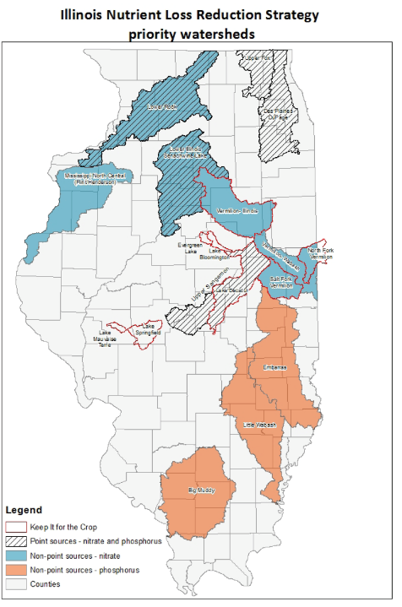
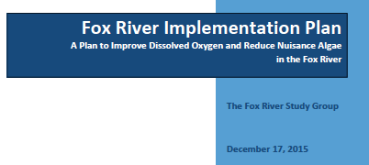
Notes:
\

Slide 10
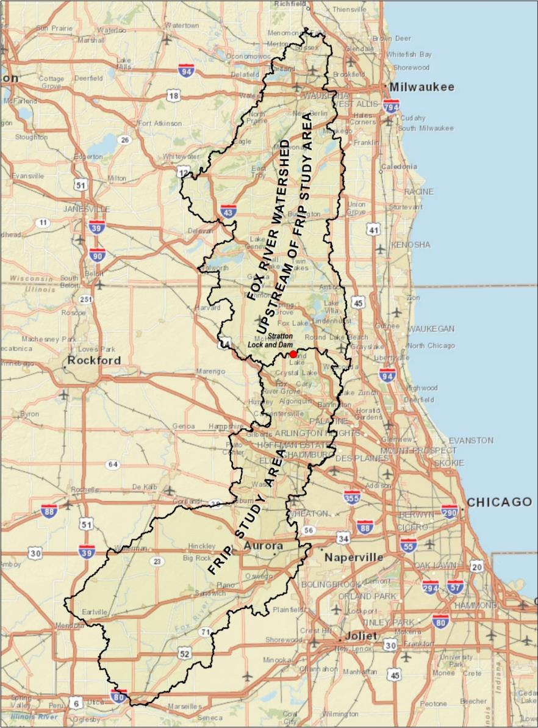
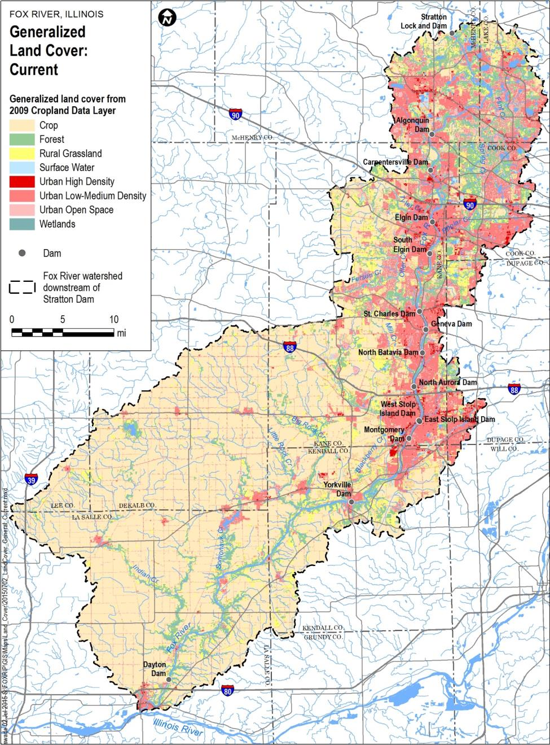
Fox River
Study Area
Fox River
Watershed

Slide 11
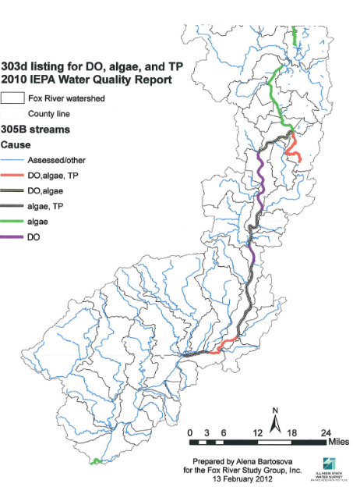
Illinois EPA
2012 Report to Congress
Mainstem of Fox River in Illinois suffers from nutrient-caused impairments—
Algae is over-fed by nutrients
Algal blooms suck oxygen out of water
Low oxygen harmful to aquatic life
Algae causes taste and odor problems for drinking water (300,000 people drink Fox River water)

Slide 12
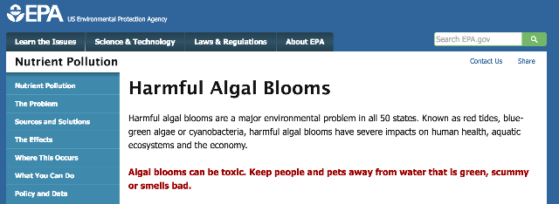
The Problem with Algae
Harmful to Aquatic Life
Drinking Water Issues
Low dissolved oxygen
Changes in plant/algae communities
Impacts on food web/chain
Taste & Odor problems
Impacts Recreation
Smelly
Interferes with boating, paddling
Toxicity to Humans, Pets, Livestock, Wildlife

Slide 13
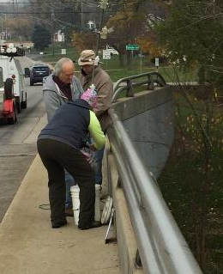
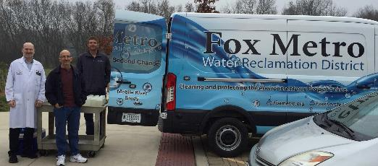
Fox River Study Group History
Fox River Study Group incorporated as non-profit corporation in April 2003
Developed & Implemented 4-Phase Workplan
  Understand available information
  Develop analysis tools- water quality monitoring & modeling
  Analyze management scenarios
    Phosphorus reductions
    Dam removal
  Implementation
Fox River Study Group begins monthly contemporaneous monitoring of 80-mile stretch of Fox River in April 2002 (ongoing 16 years, and now monitoring 7 mainstem sites and 7 tributaries)
Fox River Implementation Plan completed December 2015

Slide 14
Board of Directors
City of Aurora
City of Elgin
Fox Metro Water Reclamation District
Kane County
Friends of the Fox River
Fox River Water Reclamation District
Fox River Ecosystem Partnership
Sierra Club
Tri-Cities (Batavia, Geneva, St. Charles)
Other participants: Fox River Watershed Towns & Water Reclamation Districts, Consulting Firms, Illinois EPA

Slide 15
Sources of Phosphorus to Fox River
And during critical low flow months, wastewater is the main contributor to phosphorus feeding algae blooms that lead to substandard levels of oxygen in the water
Urban
Runoff
Wastewater

Slide 16
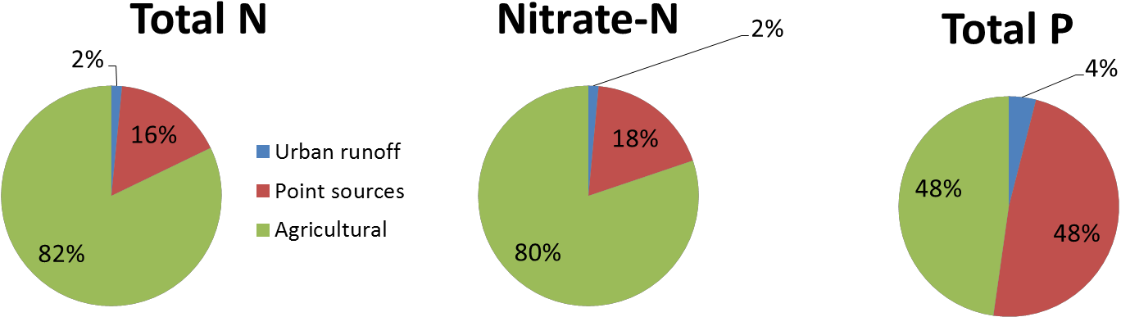
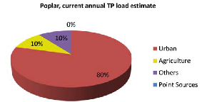
Sources of Nutrients
Statewide
Fox River-Total P
Urban
Runoff
Wastewater
Urban Tributary Example (Elgin area)-Total P

Slide 17
FOX RIVER PROFILE
950
Stream Profile of the Fox River, IL
900
Nippersink Creek
850
Big Rock Creek
Honey Creek
Carpentersville IDNR IGA renewed
800
750
Waukesha
Chain
‘O Lakes
St. Charles
Waterford
N. Aurora IDNR IGA expired
700
Burlington
N. Batavia
ELEVATION IN FEET ABOVE SEA LEVEL
McHenry
(Removed) Herds Island
Wilmot
(Removed)
Elgin
Algonquin
650
South Elgin
Geneva
600
WISCONSIN
ILLINOIS
Indian Creek
S. Batavia (Removed)
550
Stolp Island
Fox River From Chain O Lakes to Dayton
47% of River Miles Impounded
55% of River Surface Area is Dam Impoundment
Source: Fox River Fish Passage Feasibility Study
Montgomery
Dayton
Yorkville
500
450
175
150
125
100
75
50
25
0
RIVER MILES
(FROM KNAPP, 1988)

Slide 18
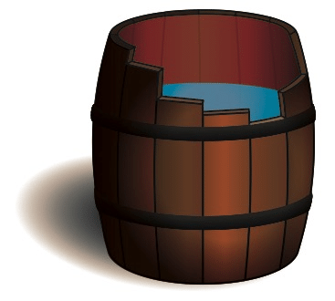
Fox River Study Group Strategy
for Limiting Algae Growth
Liebig’s Law of the Minimum
  One factor can limit growth
  Phosphorus present in smallest amounts
    Plant needs are less than nitrogen
    Easiest to limit
  Removing favorable environment for algae growth can also help
    Dam removal

Slide 19
Fox River Implementation Plan
Key Findings
Summer low flow conditions are critical times (mostly July and August, sometimes June)
Runoff plays little role during summer low flow
  Runoff clean-up can help Fox River tributaries
1 mg/L phosphorus effluent limits on large municipal wastewater plants, last by 2021
  Will reduce phosphorus loads during critical summer months by 75%
Computer models need to be improved to be able to make recommendations on how dam removal will impact dissolved oxygen levels
  (benefits on improving fish diversity and abundance well-documented)

Slide 20
Implementing the Plan—
Dam Removal
Computer Modeling
DO investigations
ISWS Fox River Water Quality Trends report
Nutrient Pollution Reduction at Wastewater Plants
Outreach to Fox River Valley Community

Slide 21
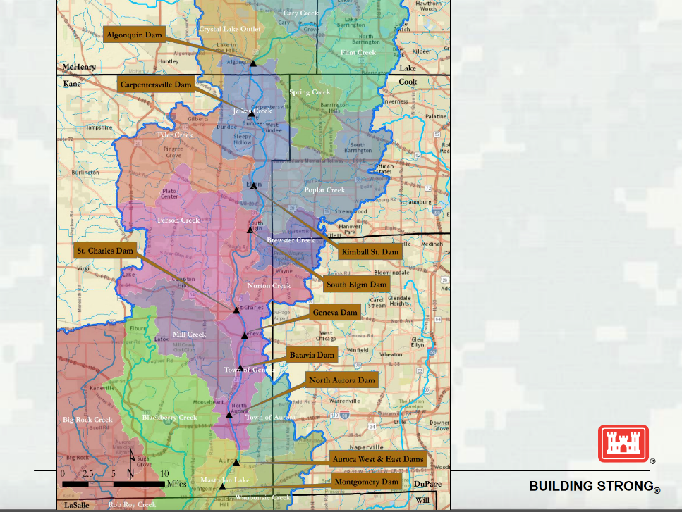

Fox River Habitat & Connectivity Study
Illinois River Basin Restoration
WRDA Sec. 519

Slide 22
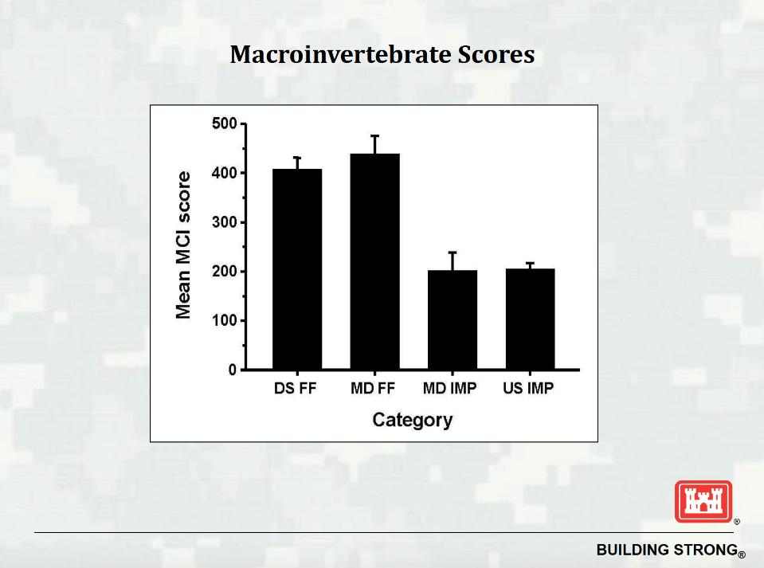

Slide 23
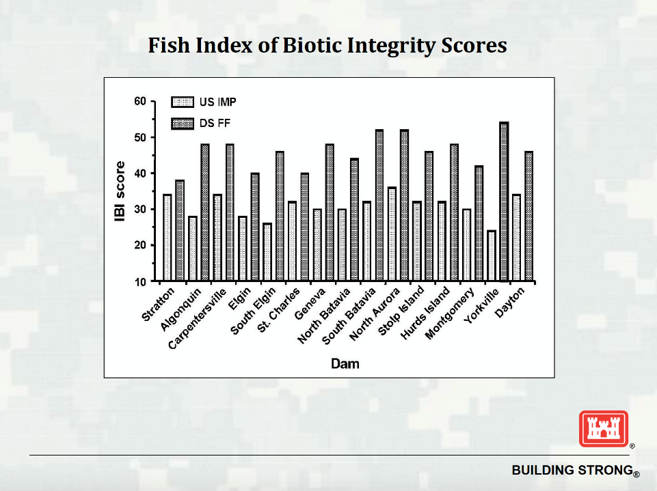

Slide 24
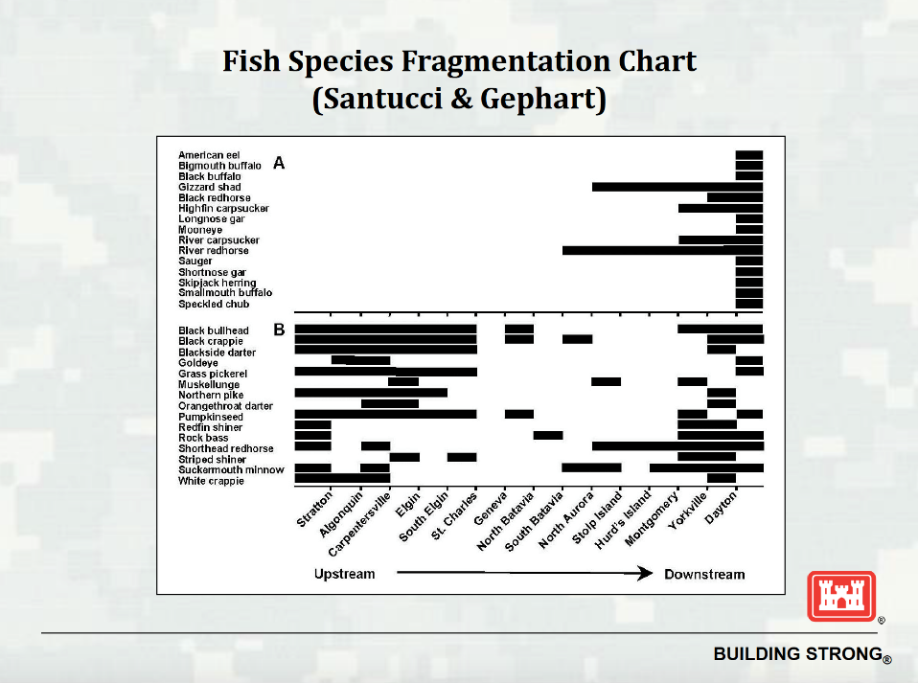

Slide 25
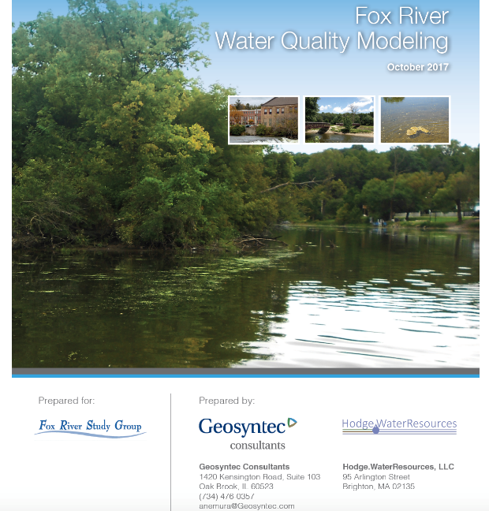
Computer Model Updates & Testing Watershed Improvement Scenarios

Slide 26

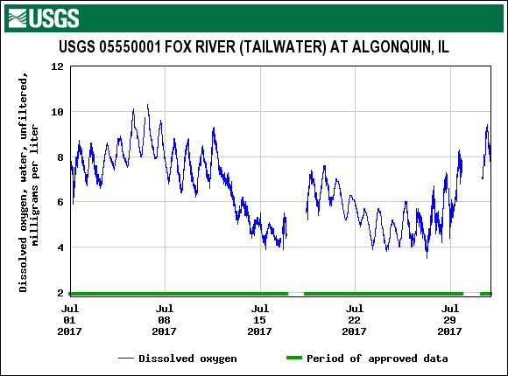
Dissolved Oxygen Measurements

Slide 27
Fox River Water Quality Trends Report
Time Period of 1997-2016
Includes 8 mainstem sites and 10 sites on 6 tributaries
Draft report this summer
Presentations in fall

Slide 28


Nutrient Pollution Reduction
at Wastewater Treatment Plants
(draft NPDES permit conditions)
Plants continue work needed to meet 1.0 mg/L annual phosphorus limits
Plants monitor nutrients in their discharges
Plants study reducing phosphorus discharges down to 0.1 mg/L
Permit provides for an annual geometric mean limit of 0.5 mg/L phosphorus by 2030, unless the FRSG Implementation Plan determines a greater reduction is necessary and achievable
FRSG Implementation Plan is updated by Dec. 31, 2022
Plants participate in the Fox River Study Group

Slide 29
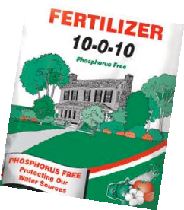
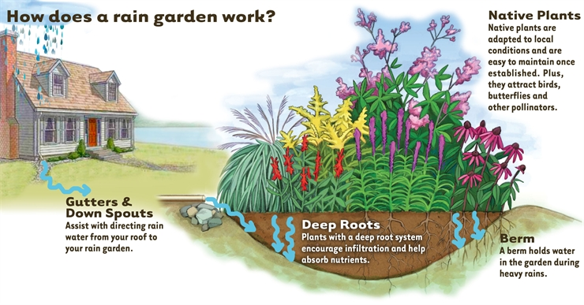
How Citizens Can Help
On one’s own property
  No-phosphorus lawn fertilizer
  Rain gardens
  Native plantings
    Don’t need fertilizer
    Don’t need water
    Help water soak into the ground
    Also helps pollinators!
  Don’t use toxic pavement sealants
Support funding of phosphorus removal at their wastewater plants
Support community green infrastructure projects
Engage with watershed and environmental groups, municipalities and the ag community in their watersheds to reduce runoff of nutrients
Graphic: Lauren’s Garden Service

Slide 30
Thank You!
cindy.skrukrud@sierraclub.org
312-251-1680 x1015

