Slide 1
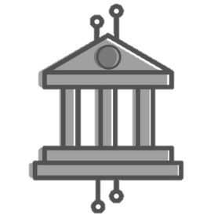
Governing
Distributed Ledgers
Developing
an Ecosystem
Integrating
Government
Illinois Blockchain Initiative ©

Slide 2
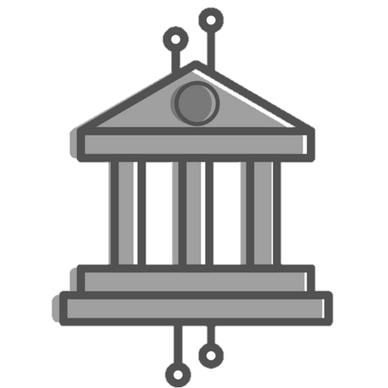
Illinois Blockchain Initiative
Illinois Department of Commerce and Economic Opportunity
Illinois Pollution
Control Board
Illinois Department of
Innovation and Technology
Illinois Department of Insurance
Illinois Department of Financial and Professional Regulation
Cook County
Recorder of Deeds
Illinois Blockchain Initiative ©

Slide 3
Insights
What is government’s role in a distributed economy?
Illinois Blockchain Initiative ©

Slide 4
Design Principles for Government ¹
Trust & Integrity
Embedded Security
Trust is intrinsic in a distributed ledger system, encoded in every process and not vested in a single member. Its Blockchain’s immutable design properties make data uniquely authoritative and nearly impossible to alter after entries are added. This increases confidence in integrity and reduces the need for federal, state and local governments to separately reconcile individual registries.
With strong cryptography and distributed computing forming the basis for the underlying protocol, governments can ensure services are highly reliable and available. Securing citizen data is not a choice or investment to be made by leadership managing government; confidence, security and authenticity are hard coded into the system.
Privacy & Rights Preserved
Shared Value Creation
The cryptographic nature of the protocol allows governments to balance transparency and privacy. Blockchains can help manage and cryptographically link owners with assets so that ownership is clear and rights are enforceable. By decentralizing data control, governments can vest privacy rights in the hands of the citizens that create it.
Blockchains systematically align incentives so that value is generated through collaborative coordination. Systems that reward shared-value creation have the opportunity to more granularly and accurately link policy-making efforts to the needs of tax payers and voters.
Distributed Power
Inclusion & Participation
Blockchains can distribute power to citizens by decentralizing administrative control and providing unparalleled personal information ownership. Decentralized control strengthens the resiliency of democratic checks and balances. When information is equally distributed, data sovereignty empowers the citizen that creates it not the agency that stores it.
Not one participant controls a blockchain and everyone has consistent, equal access to all records added to the ledger. An integrated government mechanized and automated by distributed ledgers allows leadership to focus its policy and administrative efforts on a governing process that is inclusive of all citizens and tailors services specifically their needs.
^{1.} Adapted from: Tapscott, Don, and Alex Tapscott. Blockchain Revolution: How the Technology Behind Bitcoin Is Changing Money, Business, and the World. 2016.
Illinois Blockchain Initiative ©

Slide 5
Government’s Role
Developing an Ecosystem
For Growth and Collaboration
Modernizing Governance for a Distributed Economy
Integrating Services for a
Highly Efficient Government
Although, the long-term benefits of blockchain for industries, the economy and society are clear, blockchains and DLTs are still very much nascent technology. Governments can play an role in catalyzing its maturity as a technology by supporting grassroots developer innovation.
Effective governance in a distributed economy will require legislative agility beyond what rules and regulations can provide. Modern governance will need to carefully balance a combination of broad policy principles, technology standards and “code”.
A “hyperconnected” government enables unprecedented transparency, and efficiency, where services are tailored to individual’s needs. Blockchain and DLT will be used to connect disparate entities within and across regional, municipal, and state entities around citizens, businesses and assets.
Illinois Blockchain Initiative ©

Slide 6
Developing an Ecosystem
Supporting Entrepreneurship
Collaborating with Enterprises
Fostering a Talent Pipeline
Partnering with educational institutions to incorporate curriculum into schools and colleges to support workforce development.
Build relationships with entrepreneurs and leaders to foster a supportive environment for startups and investment.
Encourage startup/enterprise collaboration. Help enterprises partner with promising startups in the ecosystem.
Illinois Blockchain Initiative ©

Slide 7
Governing Distributed Ledgers
Governance in a distributed economy will require a thoughtful balance of providing broad policy goals, participation in standards setting, and developing technical code to maximize value for both citizens and businesses.
Technical Code
Technical code can be an effective governance tool when it reduces market frictions/regulatory burdens and also achieves its broader policy goals. Regulators can provide “utility services” that are pluggable into blockchains, standardizing cross-industry components such as identity or fiat digital currency. In other instances governments can provide profit-neutral services (i.e. escrow as a service for real estate) in areas where economic risk is concentrated or there is little incentive for participants to collaborate.
Technical Code
Standards Participation
Governments have the unique ability to work across industries and protocols to ensure technology standards harness network effects, promote interoperability and minimize redundancy. By acting as neutral arbiters in the “standard setting” process governments can help minimize risks such as coordination costs.
Standards Participation
Policy Goals & Principles
By participating in the formative days of the technology, governments can ensure broad policy goals such as transparency and public engagement are incorporated into the core design of the system and so that the benefits of “decentralized coordination” are illuminated.
Policy Goals and Principles
Illinois Blockchain Initiative ©

Slide 8
Integrating Government
Singular, Citizen-Centric Identity
Identity Attributes & Attestations
Assets & Ownership Registries
Public addresses on a blockchain can be used to form the basis of a unified citizen ID across multiple departments and systems. A fit-for-purpose distributed ledger could be used as a new type of master data management system, maintaining a single source of truth for all government recordkeeping.
Identity attributes (credentials or attribute claims) can be issued and cryptographically linked to a citizen’s unique ID. Each department can append attributes to a citizen’s credential or claim repository that is managed on a government distributed ledger, but owned by and sovereign to a citizen or business entity.
Under this “networked” system asset and property can also be issue unique IDs. Ownerships such as real property, vehicle, fire arm or even intangible assets can be cryptographically tied to a citizen’s unique ID. Blockchains and smart contracts can efficiently keep record of asset ownerships and their tradeable value.
Illinois Blockchain Initiative ©

Slide 9
Progress & Horizon Scanning
What have we accomplished and where do we plan to go?
Illinois Blockchain Initiative ©

Slide 10
Progress to Date
2016
Illinois Blockchain
Initiative Launched
Digital Currency Guidance Issued
RFI for Blockchain Applications Released
2017
Proof-of-Concepts
in Development
Chicago Blockchain Center Opens
R3, Hyperledger &
EEA Partnerships
2018
Blockchain Hackathon Underway
Task Force
Formed
White Paper
Released
Illinois Blockchain Initiative ©

Slide 11
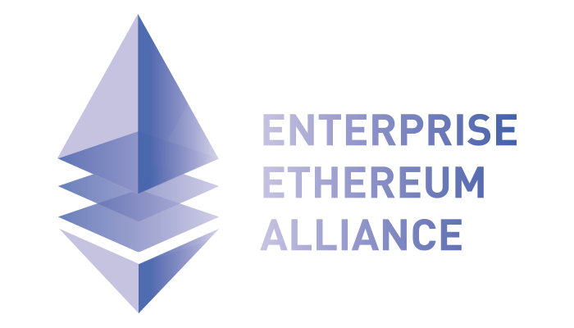
Developing an Ecosystem: Partnerships
Illinois Blockchain Initiative ©

Slide 12
Developing an Ecosystem
Quarterly Seminar Series
Student Hackathons
Local Meetups
University of Illinois
Partnership
Blockchain Legislative
Task Force
Chicago Blockchain Center
Illinois Blockchain Initiative ©

Slide 13
Governing Distributed Ledgers
Digital Currency Regulatory Guidance
Department of Financial and Professional Regulation (IDFPR) released guidance, taking light-touch regulatory approach to digital currencies while also providing certainty for businesses operating in the space.
R3 and Enterprise Ethereum Partnership
IDFPR signs partnership agreement with R3 CEV and Enterprise Ethereum Alliance (EEA) financial services consortiums As a member of R3 the IDFPR will be participating in the firm’s RegNet and banking/ regulatory working group. As a member of EEA the State is actively participating in identity and pharma/ supply chain working group, defining use cases and technical standards
Illinois Blockchain Initiative ©

Slide 14
Integrating Government: Pilots
Property Deed Recording
Academic Credentialing
Health Provider Registries
Energy Credit Marketplace
Vital Records
Cook County Recorder of Deeds will be the first land titling office in the US to record property transfer on the blockchain. The goal is to expand the scope of the program, the extensibility of the solution while also providing the solution to other Illinois county recorders.
Partnering with the University of Illinois to issue academic credentials/transcripts on a blockchain. MVP focuses on credential verifications, with the goal of recording transcripts of all Illinois institutions on a distributed ledger for students/employers.
Healthcare payers spend over $2.1b a year reconciling a few discrete health provider data fields issued by CMS, DEA and state boards. Provider data, starting with the state licensing board would be entered onto a distributed ledger acting as a single source of truth dataset for providers and payers.
Energy producers are issued tax credits when producing “green” energy. Program would include standing up a marketplace where REC could be traded. Credits would be granularly divisible. Potential to improve traceability and liquidity, providing better “green” energy policy outcomes.
Vital records such as birth events to be placed on a distributed ledger. Birth records allow the state to issue a digital identity tied to a person’s birth that could be managed on a distributed ledger, adding attributes to it as the citizen interacts with different agencies throughout his/her lifetime.
Illinois Blockchain Initiative ©

Slide 15
Illinois Blockchain Initiative (IBI) Contacts
Cab Morris, Deputy Director of Strategy and Operations
Department of Financial and Professional Regulation
richard.morris@Illinois.gov
Jennifer O’Rourke, Illinois Blockchain Business Liaison
Department of Commerce and Economic Opportunity
jennifer.orourke@Illinois.gov
Illinois Blockchain Initiative ©

Slide 16
Illinois Blockchain Initiative
Illinois Blockchain Initiative ©

